Slide 1
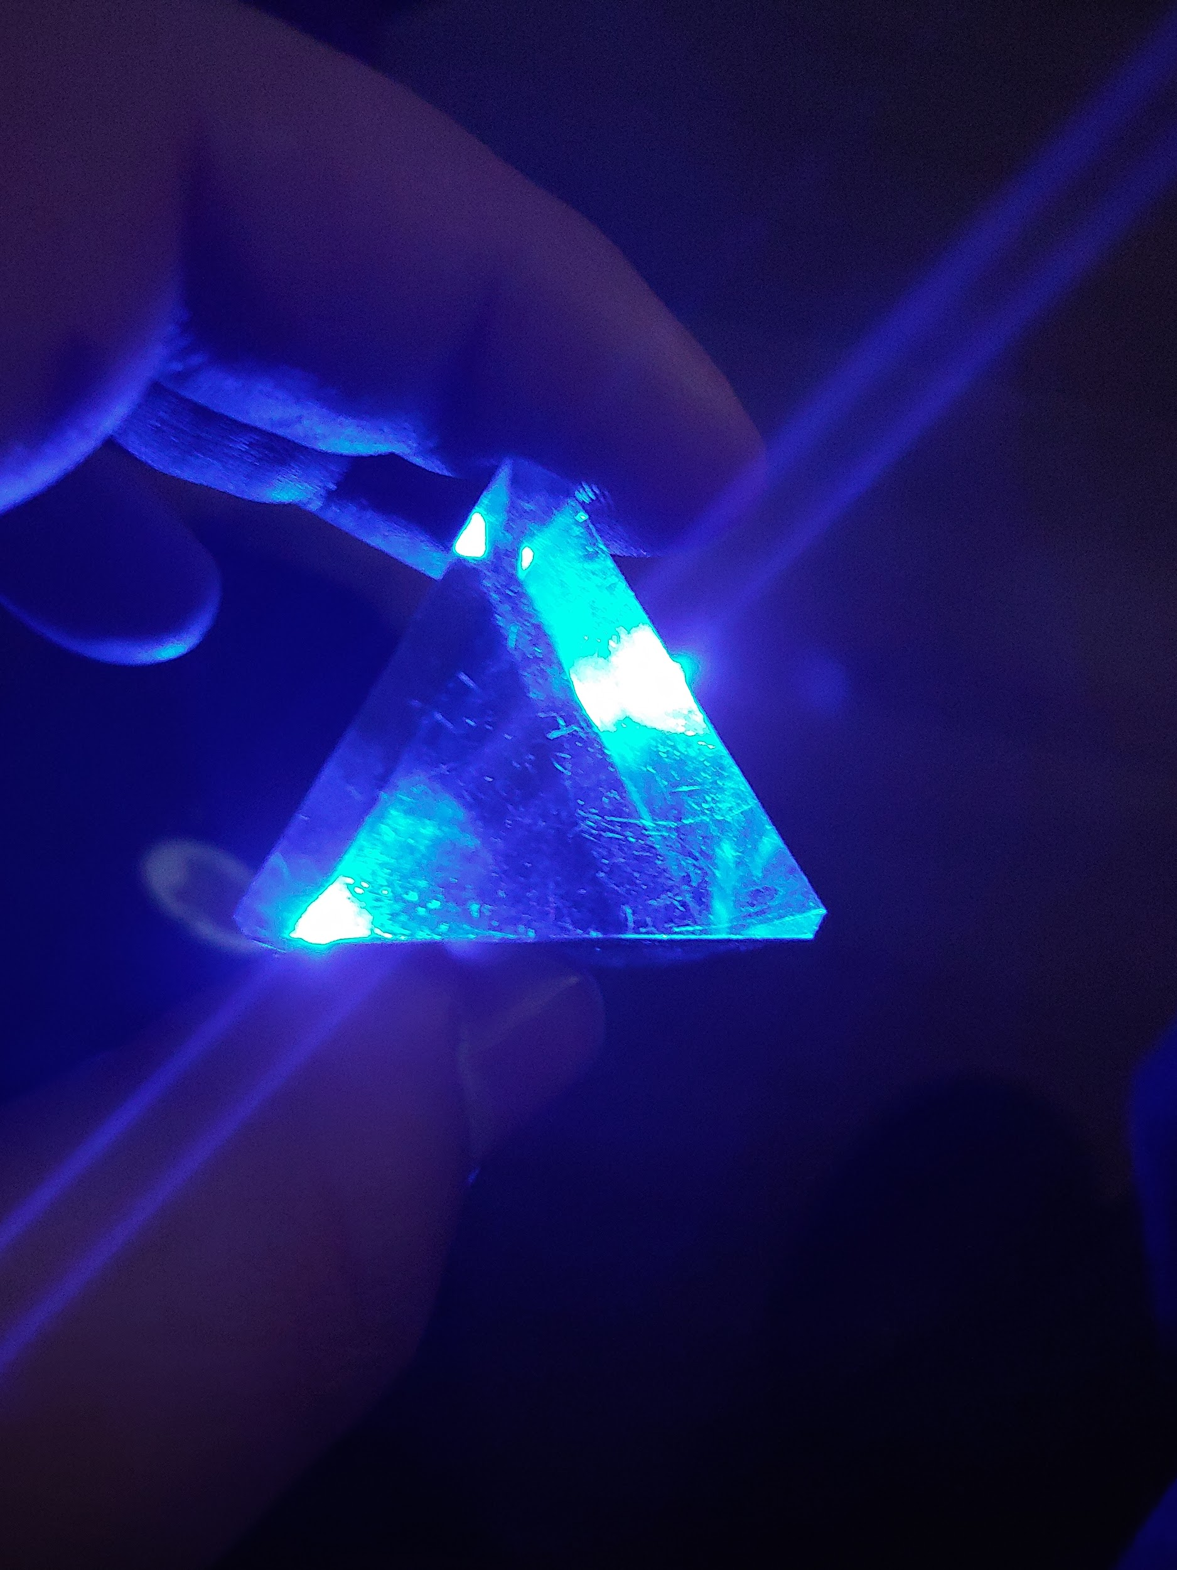
Black Light Demo &
Tape Filters
By: Luke & Danny
#nofilter #iphonephoto
#LgG7

Slide 2
Very bright lights will hurt your eyes

Slide 3
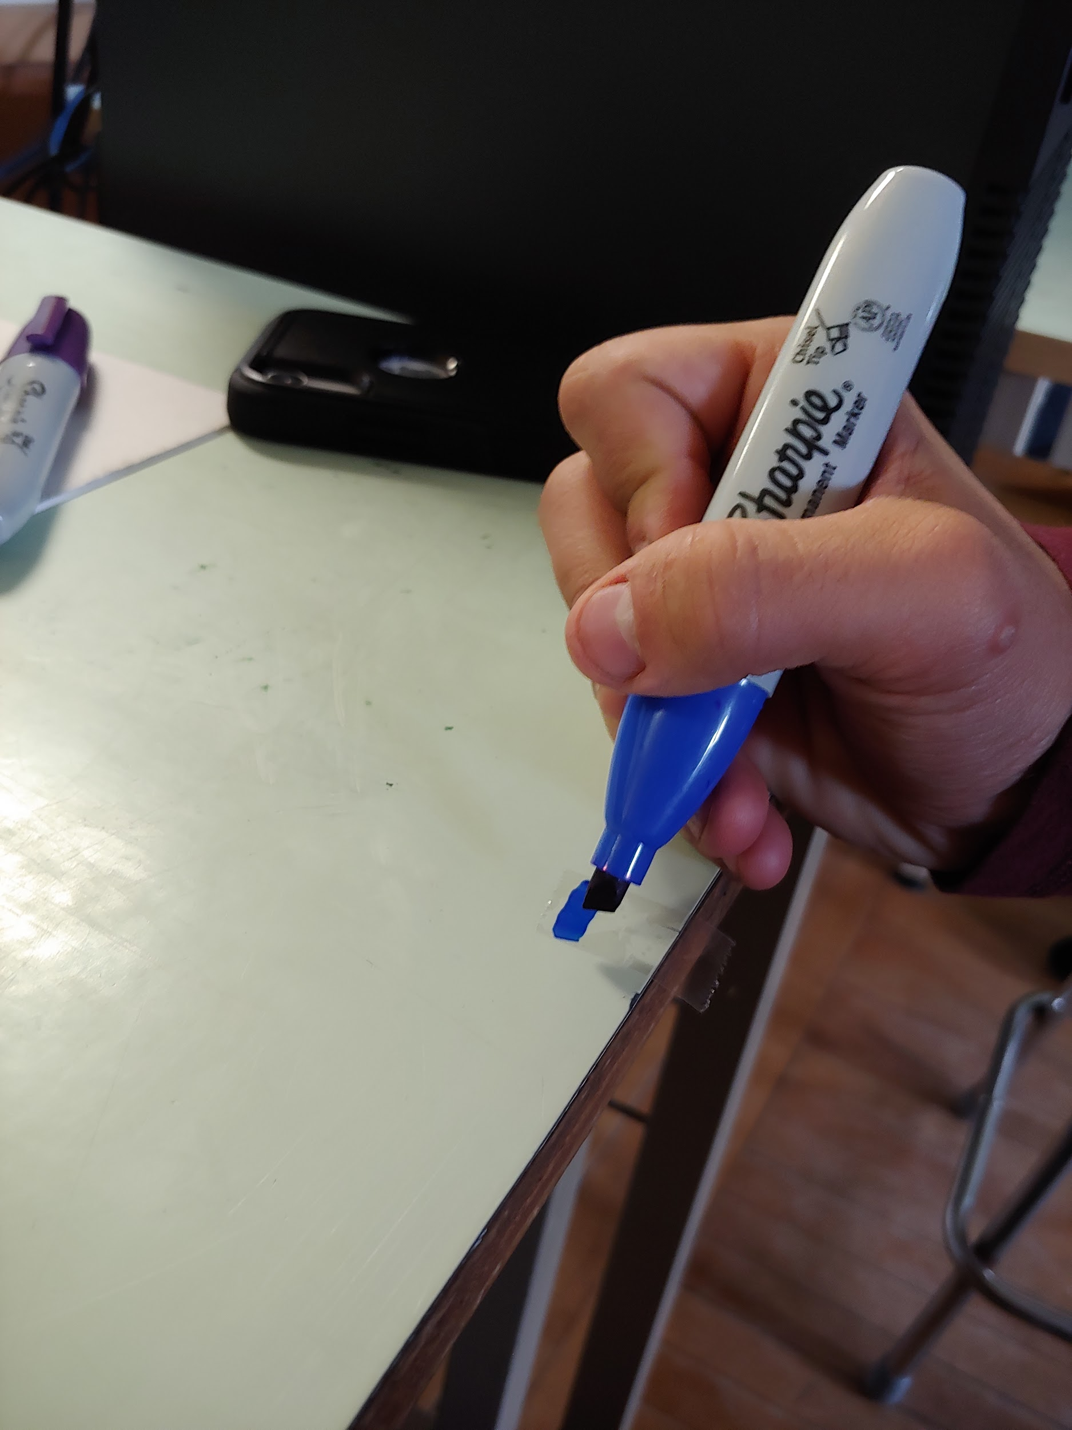
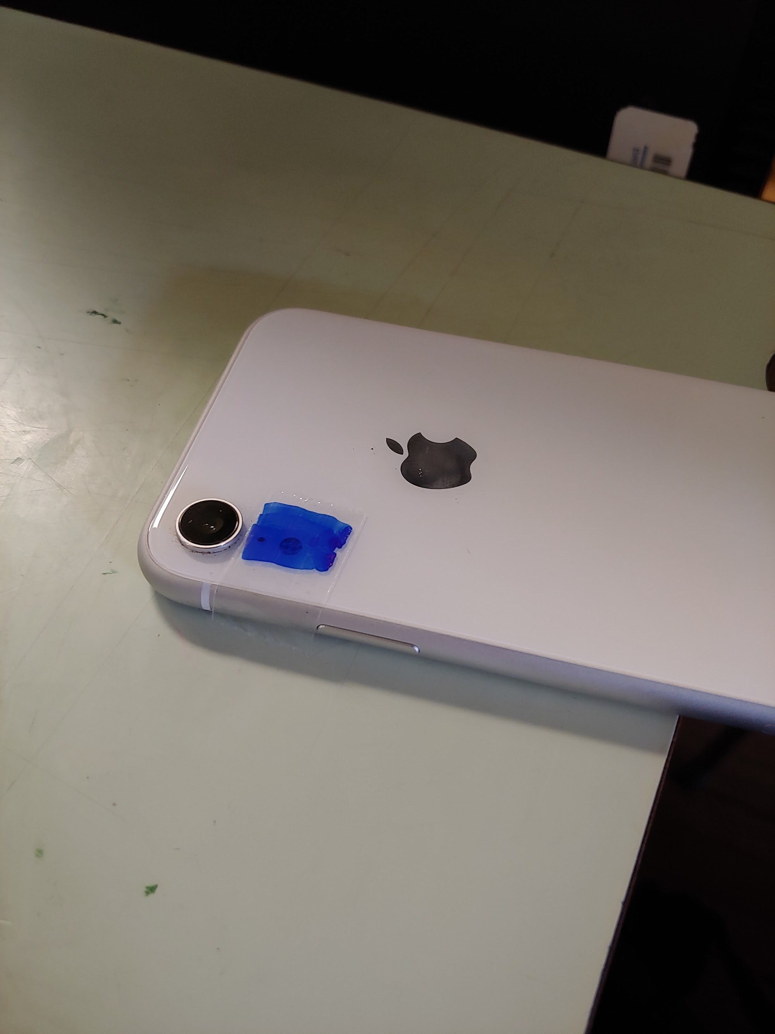
Use clear tape and put blue marker on the non sticky side.
Put the blue colored tape over phone flashlight.

Slide 4
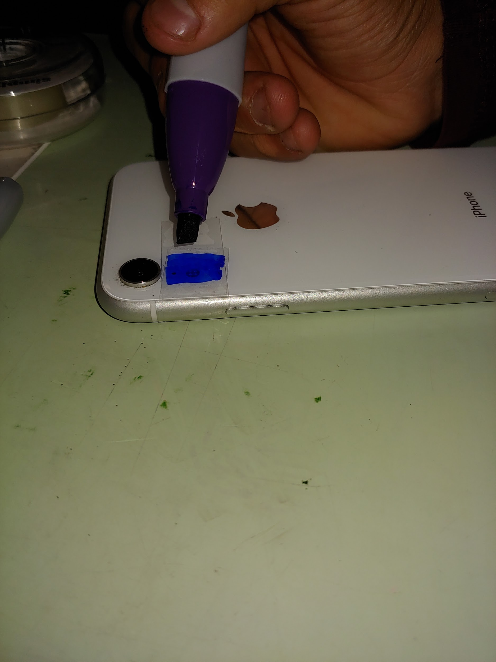
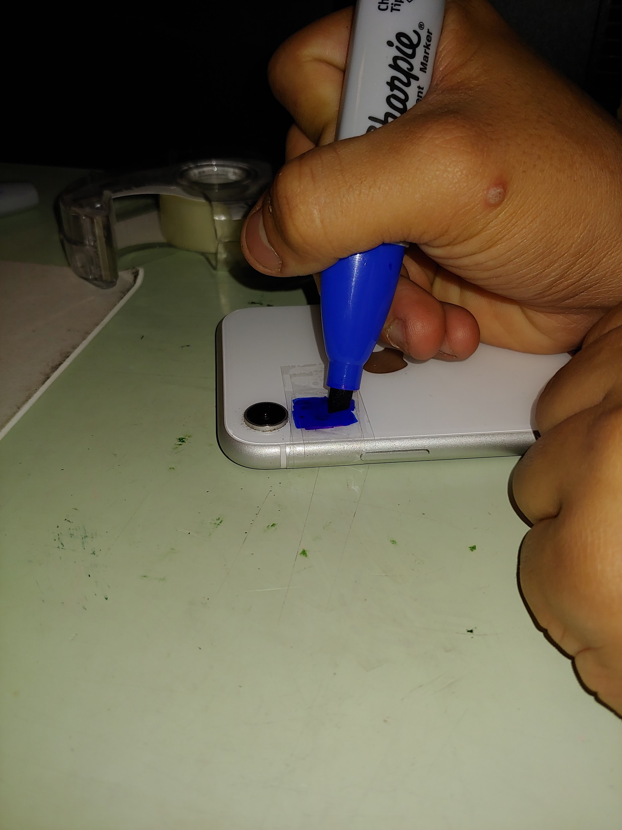
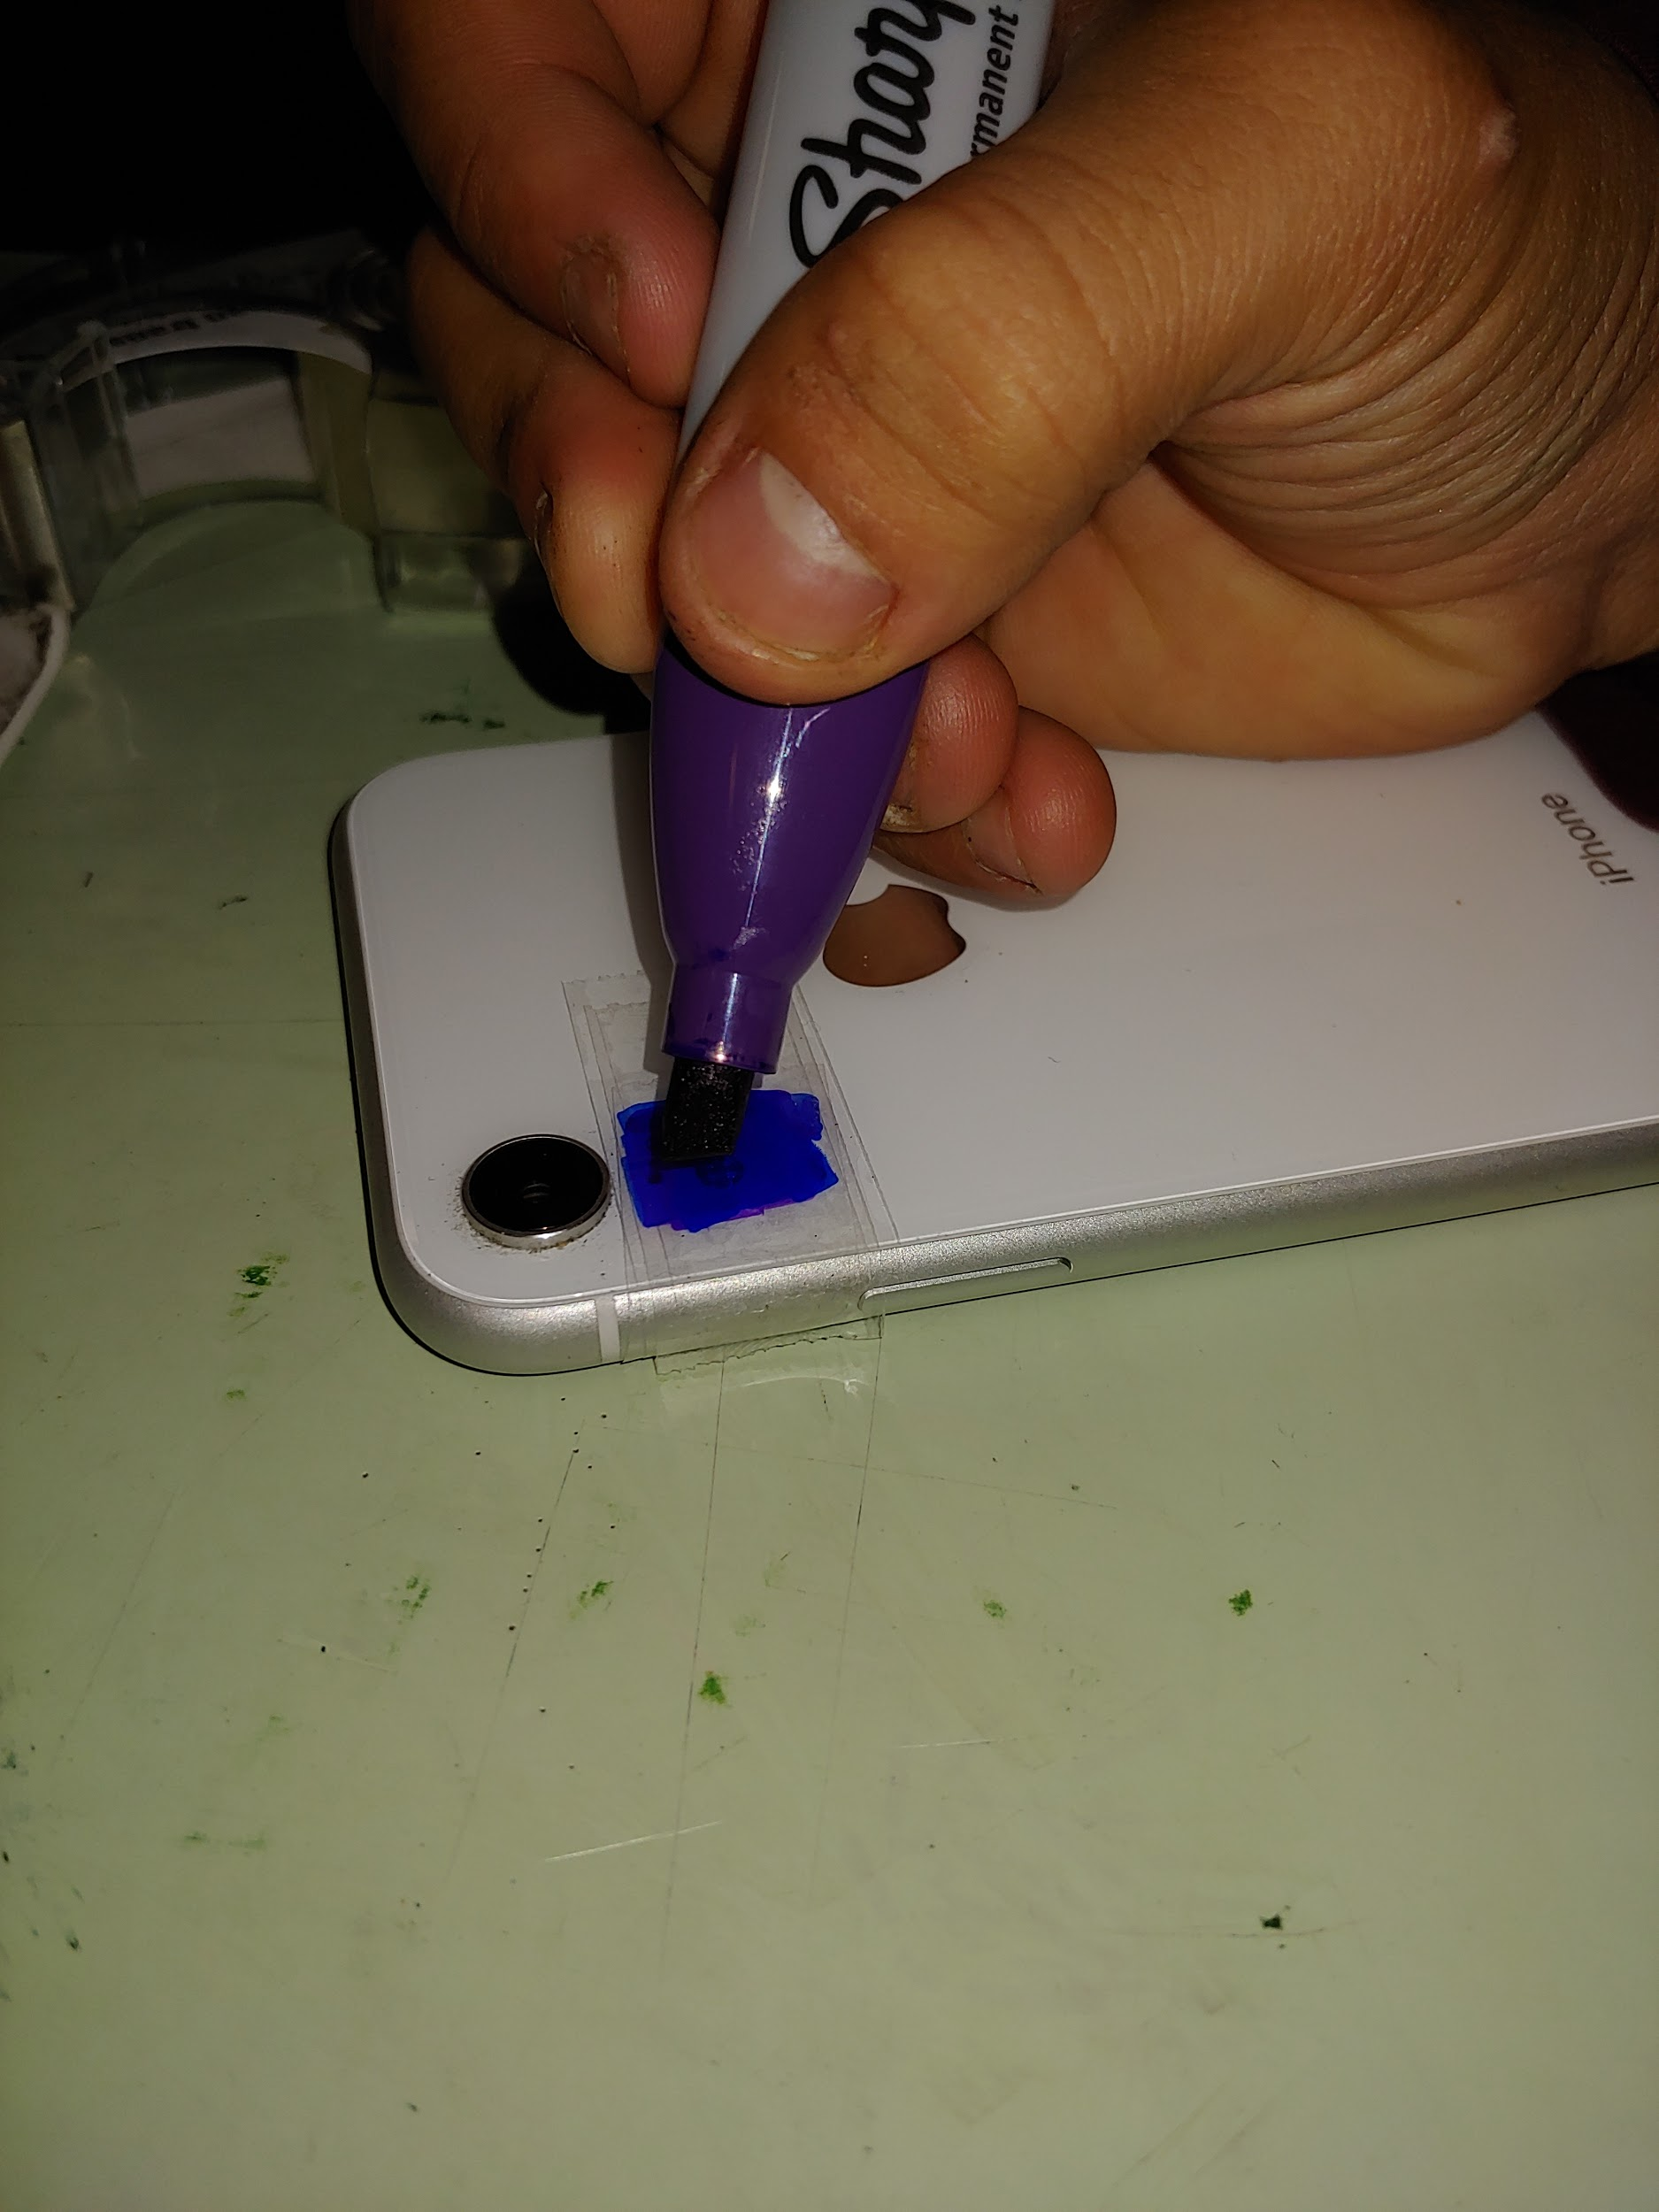
Repeat with purple on another piece of tape
Layer on another blue piece of tape
Layer one last piece of purple tape
Blue tape + Purple tape + Blue tape + Purple tape + One clear piece of tape on top to prevent smudging

Slide 5
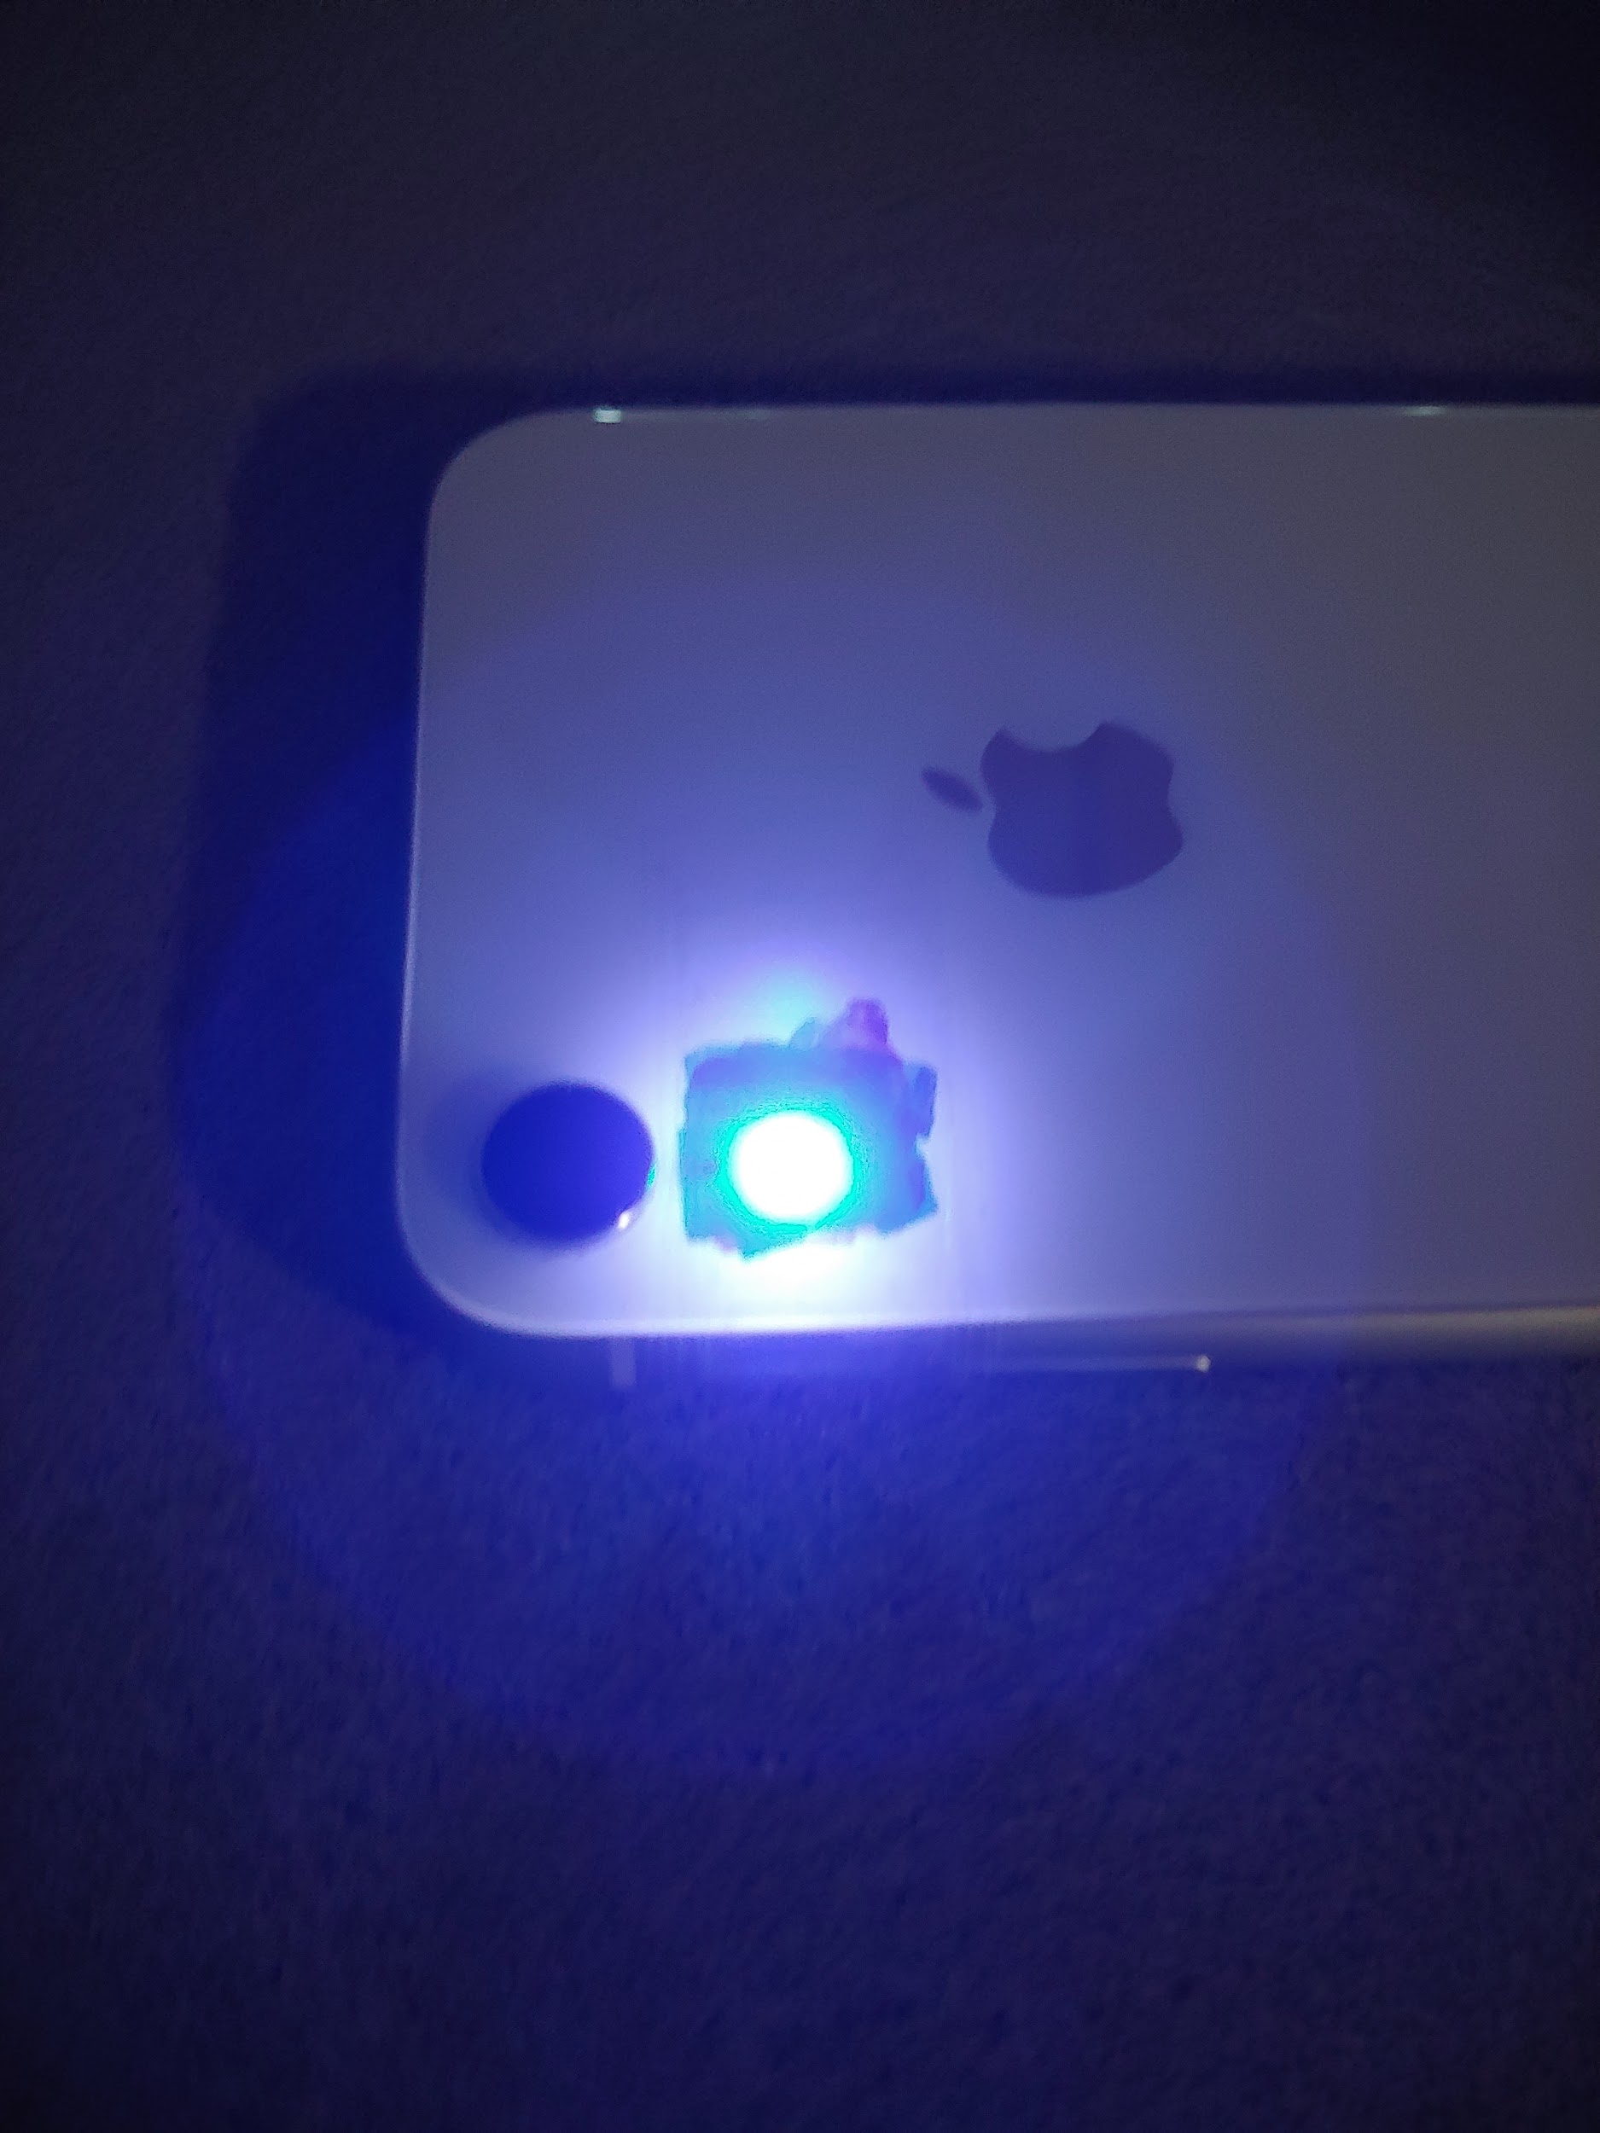
So what does that get you?
This is a homemade blacklight. Although you can't see fingerprints or other things but it allows you to see certain colours.

Slide 6
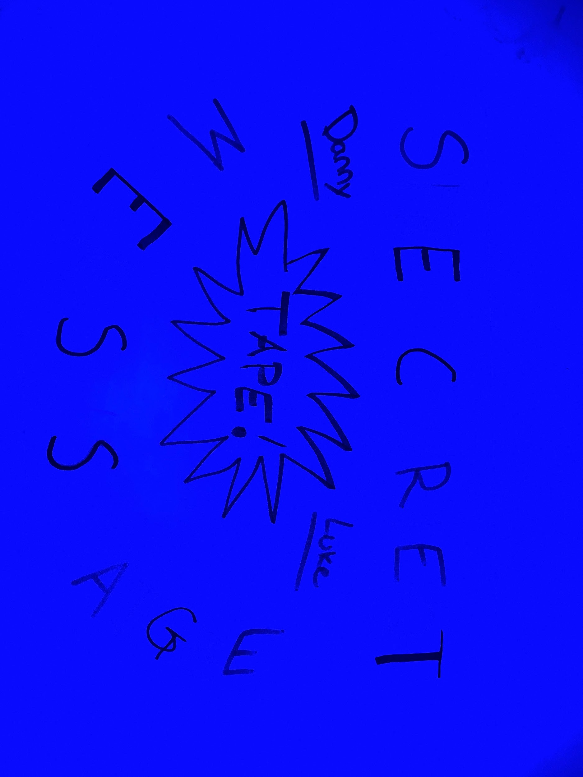
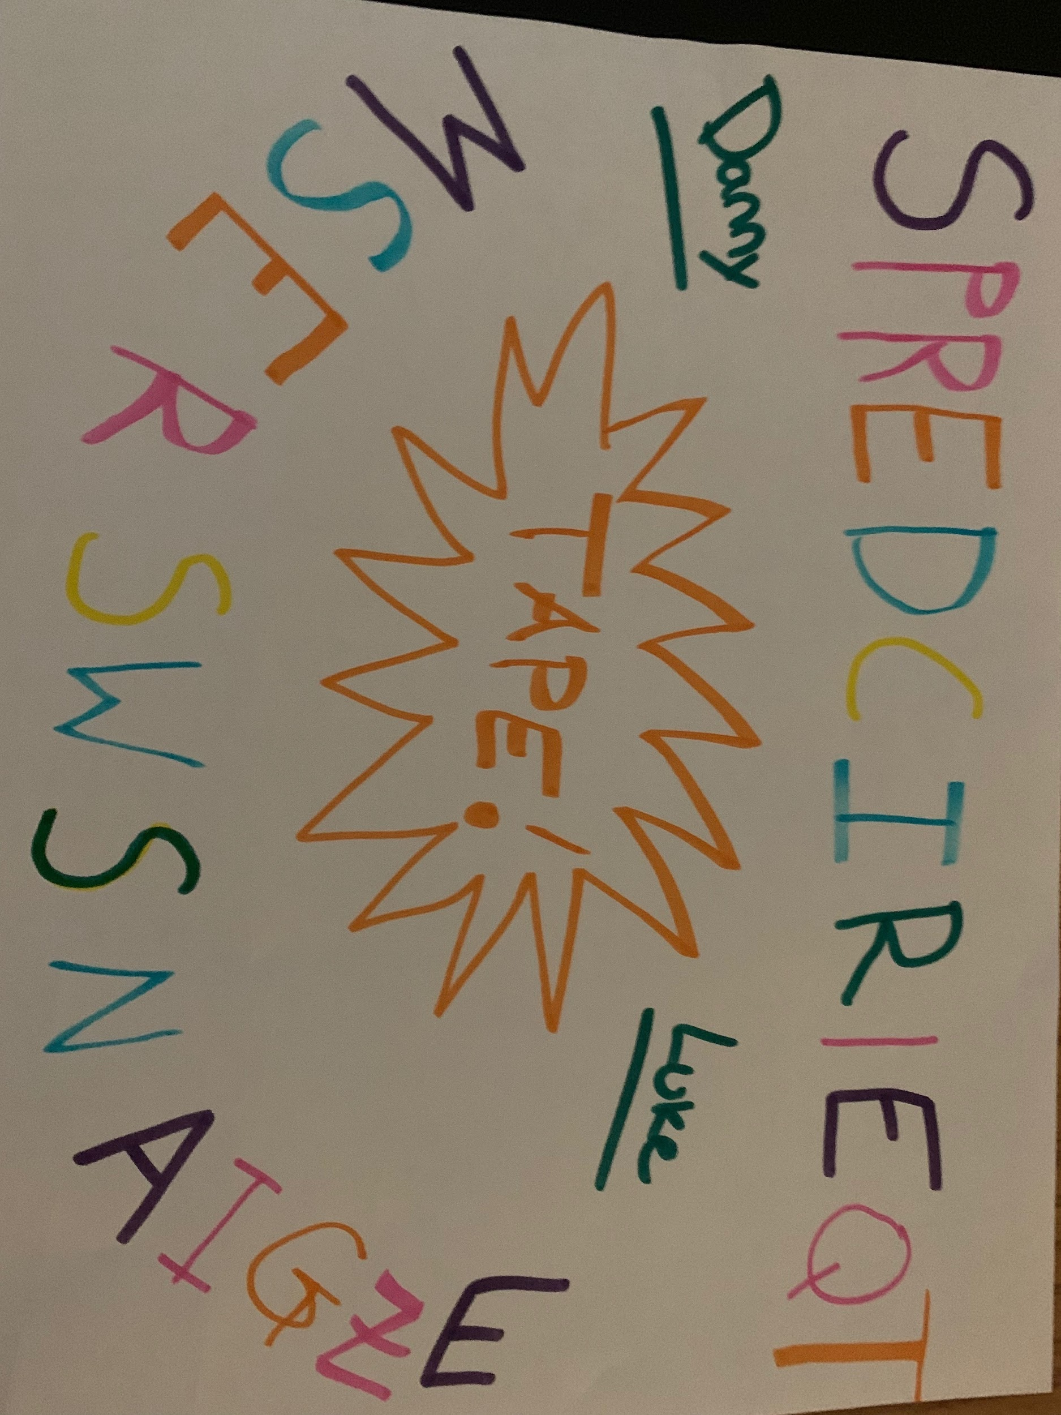
If you look at the image on the left you can see that the words don't make any sense, but if you shine that blacklight you can see certain colours such as purple yellow green and orange.
Note: Different markers will have different effects. It’s all trial and error.

Slide 7
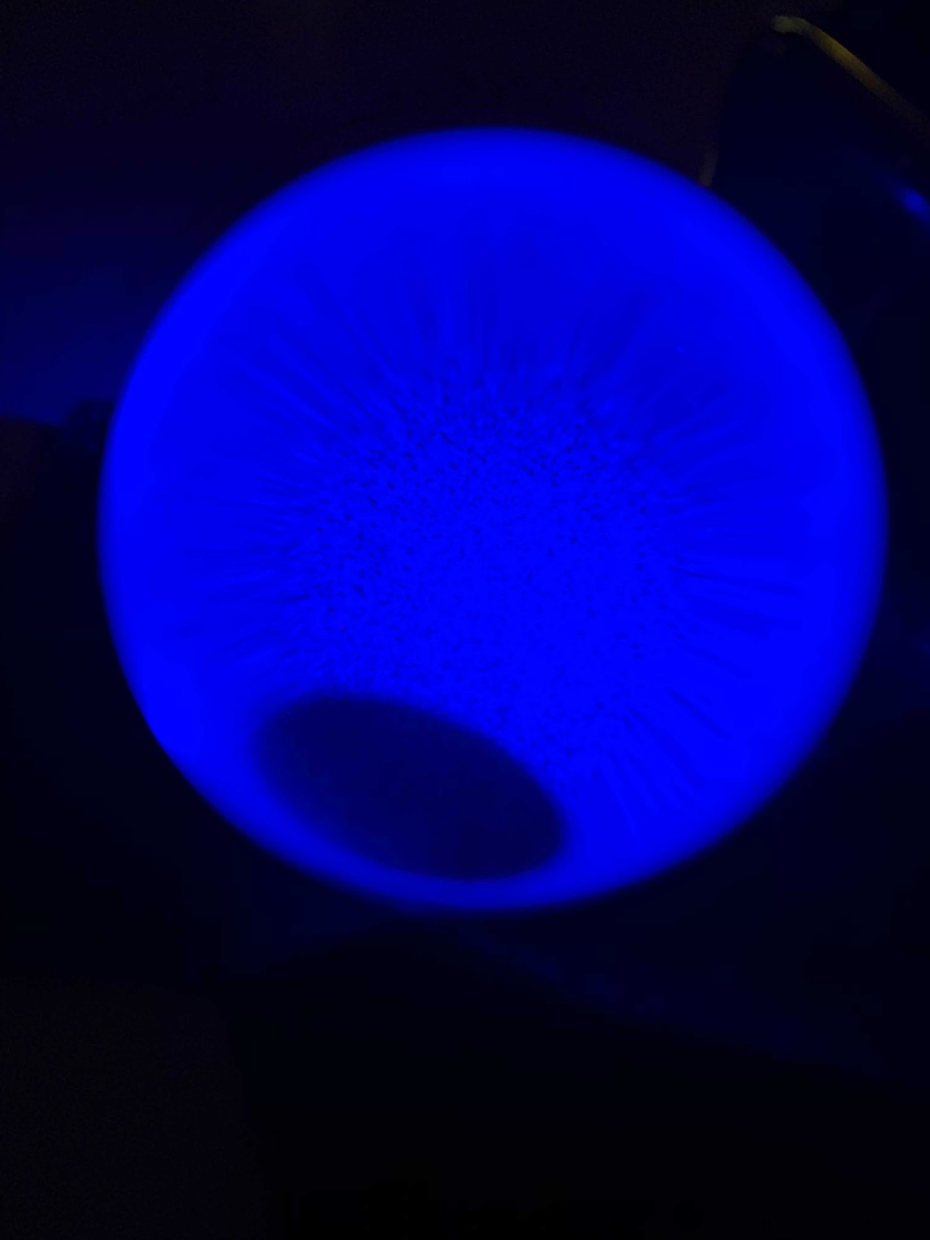
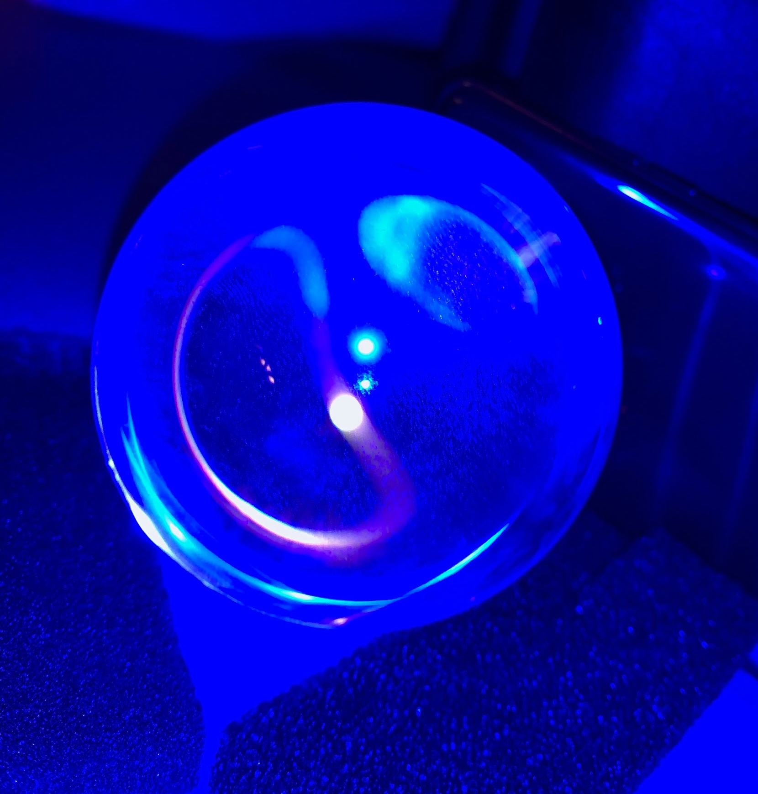
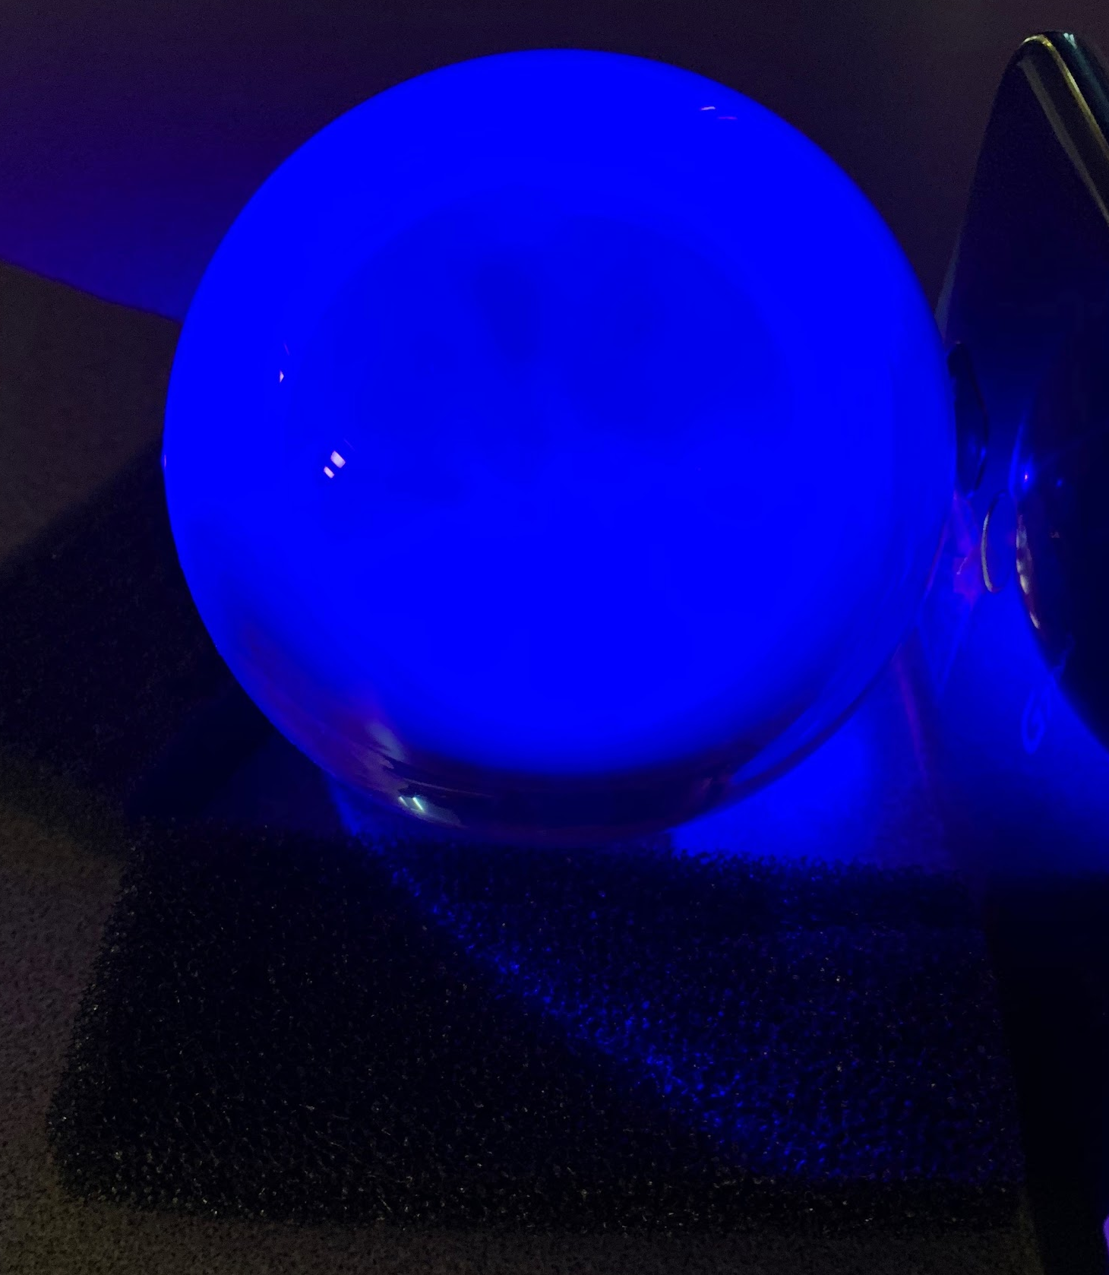
This is what happens when You shine the light at A crystal ball.

Slide 8
Here is one with a prism.
Note: Taken with an android phone.

Slide 9
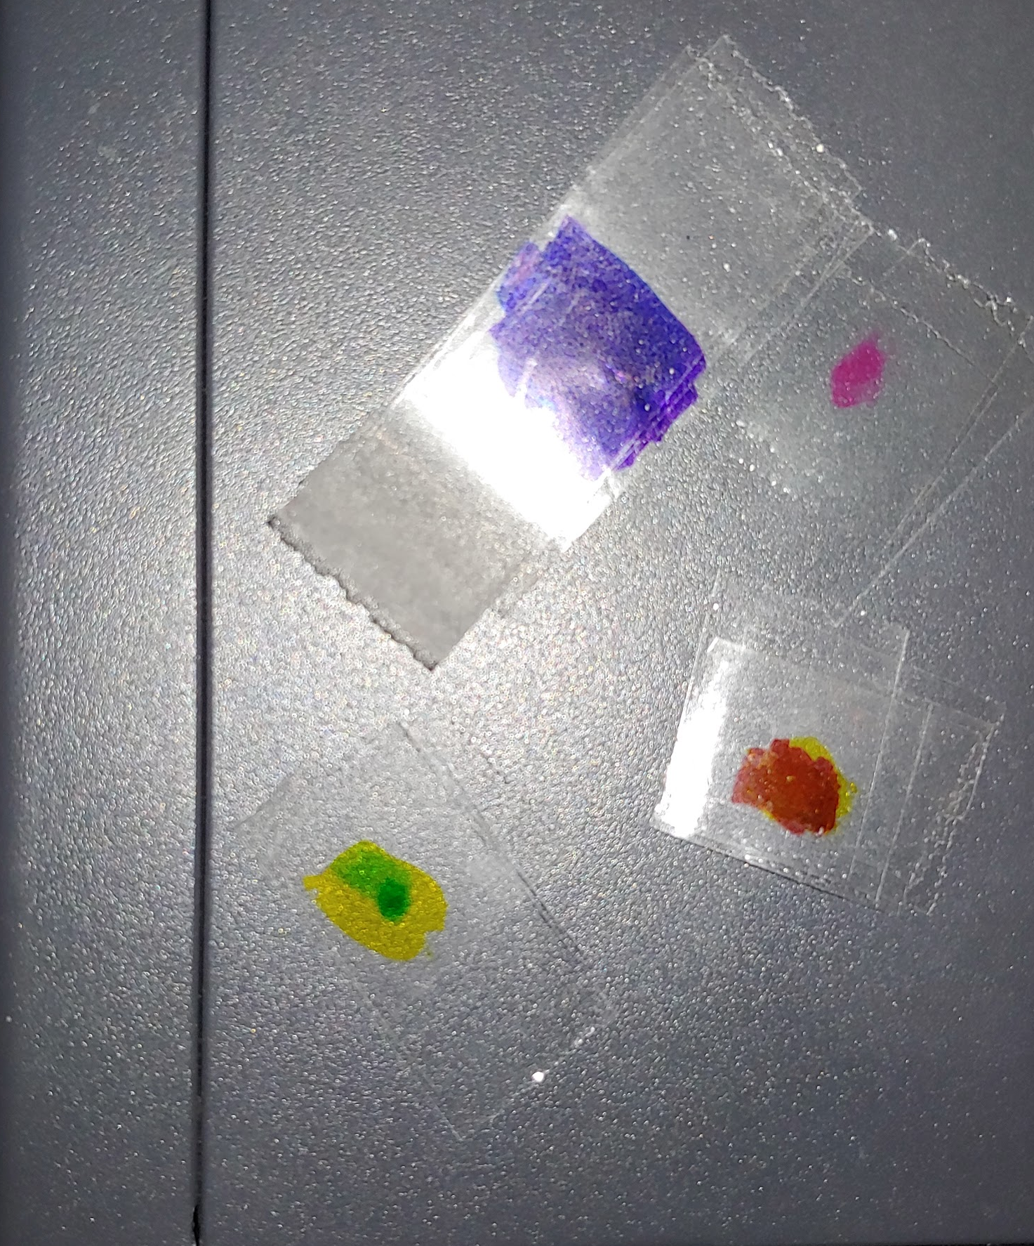
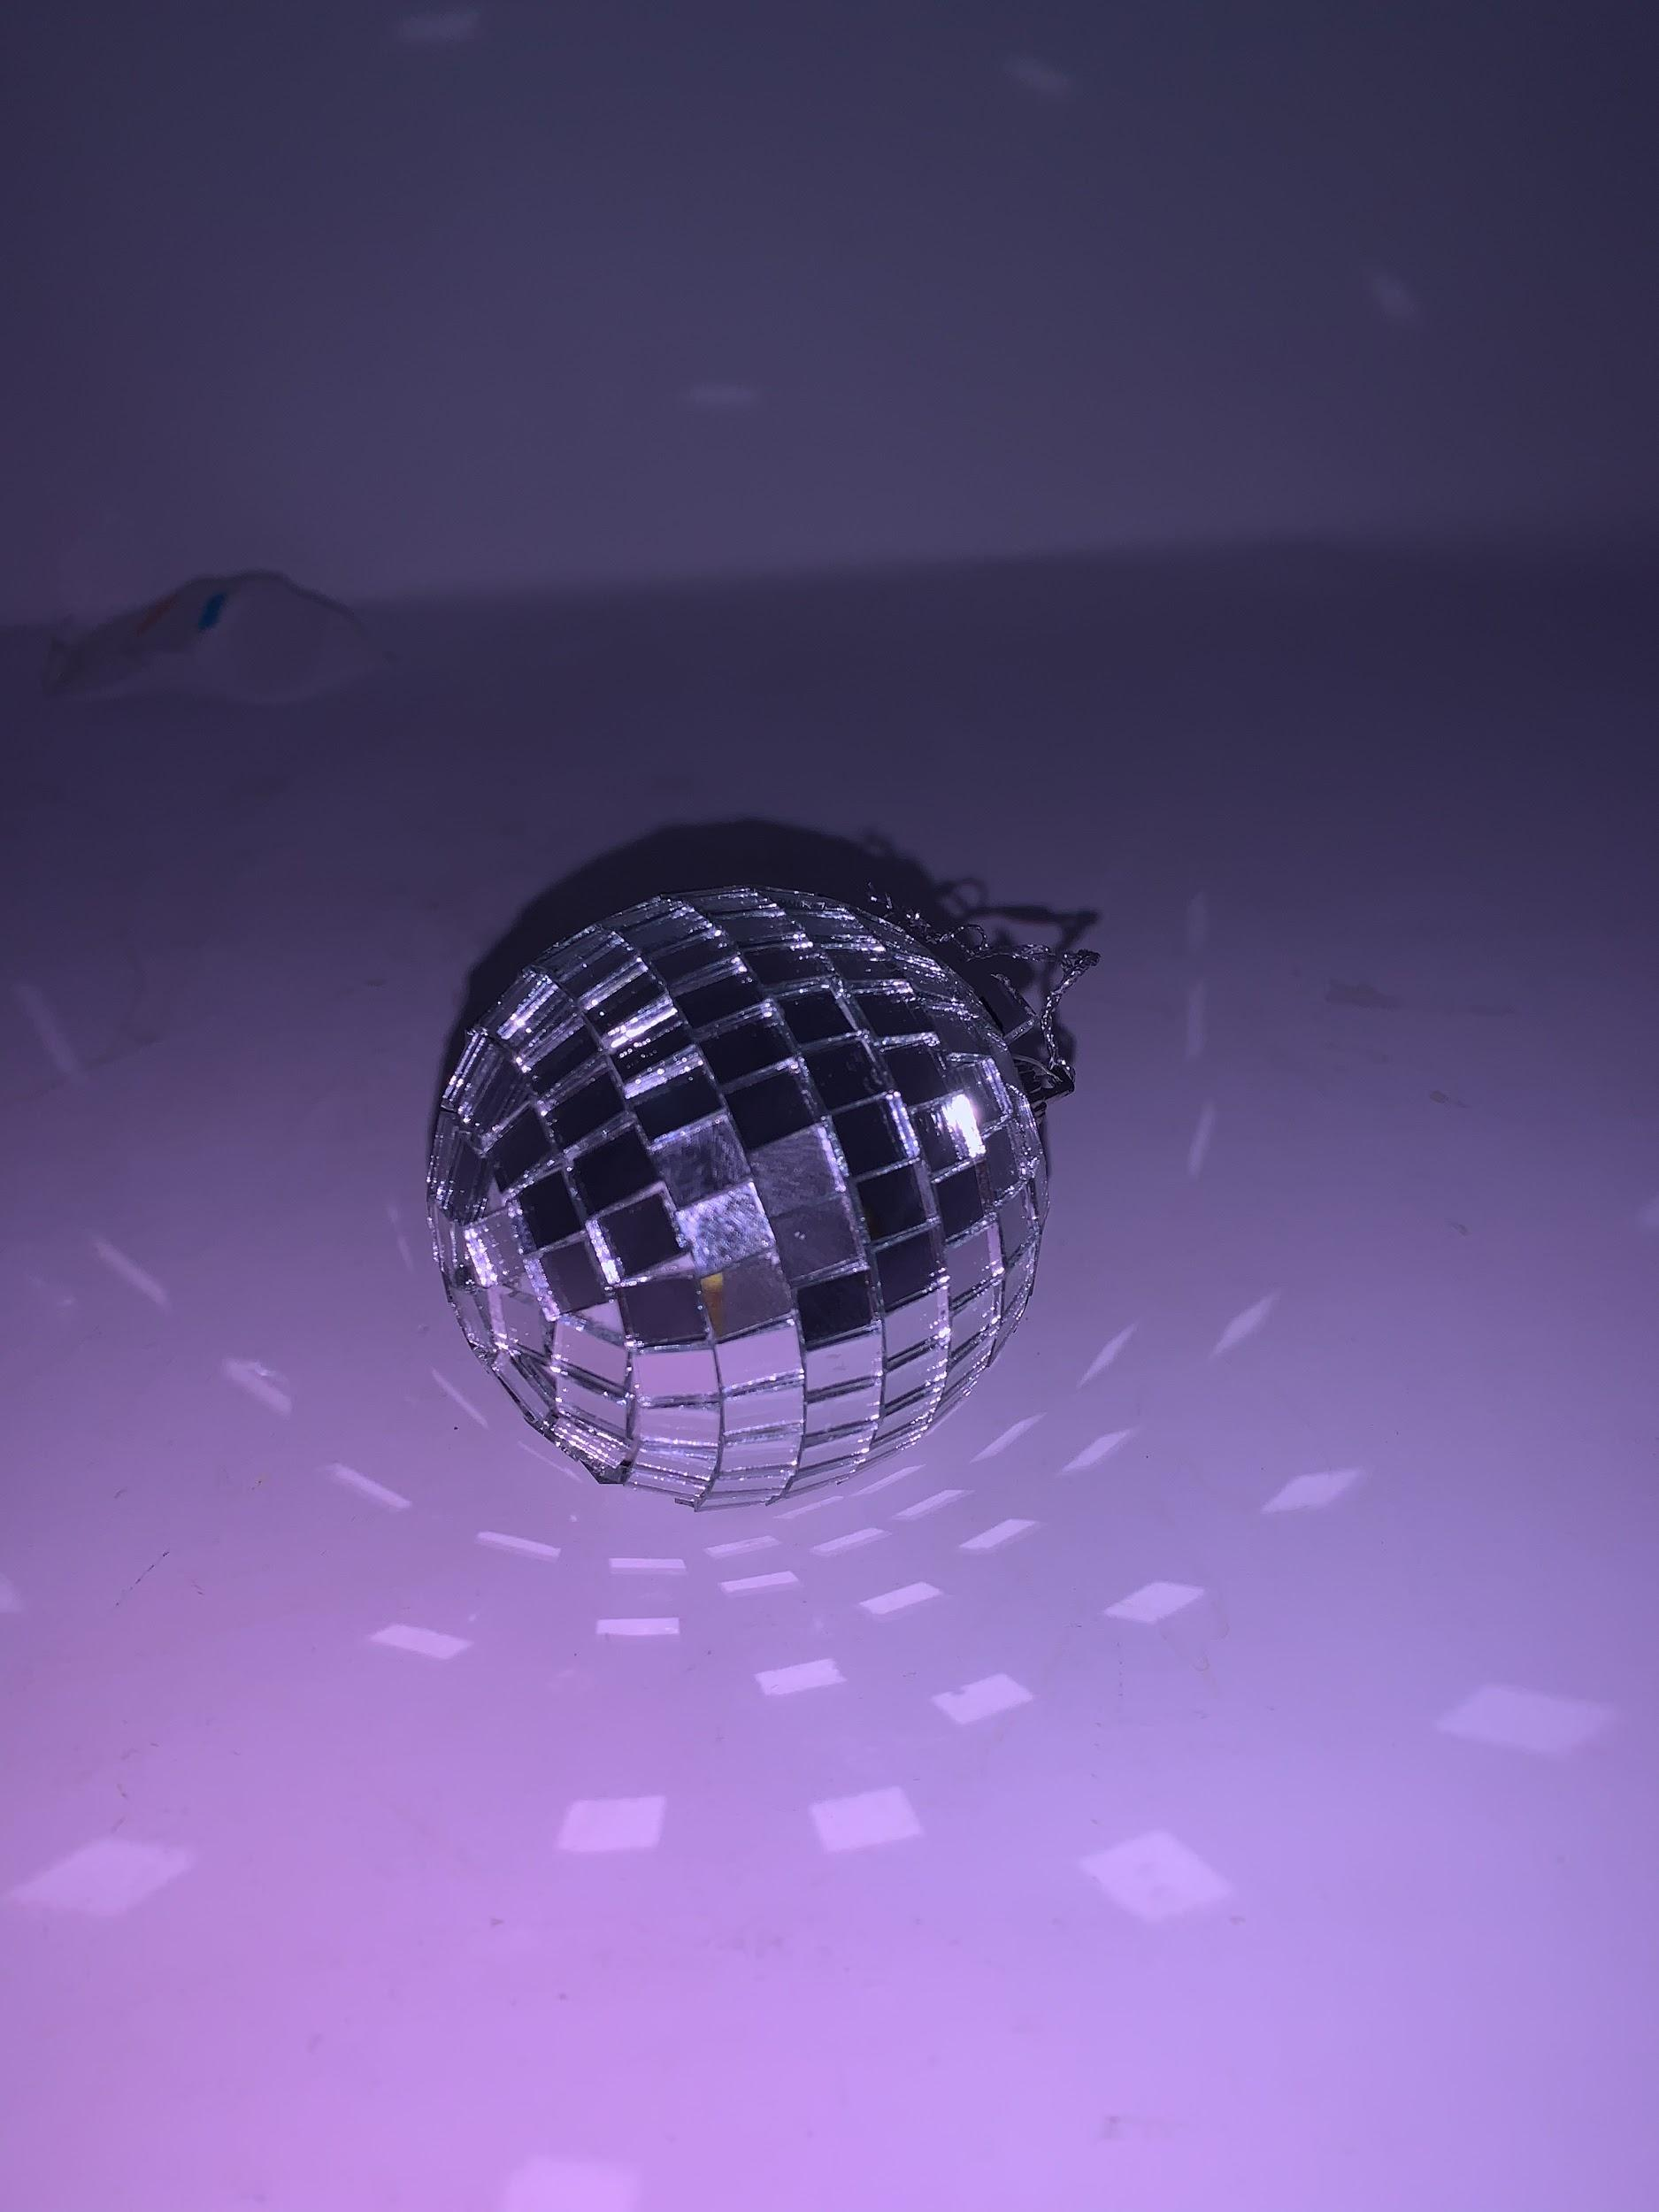
So what else can you do?
You can make almost any colour Filter.

Slide 10
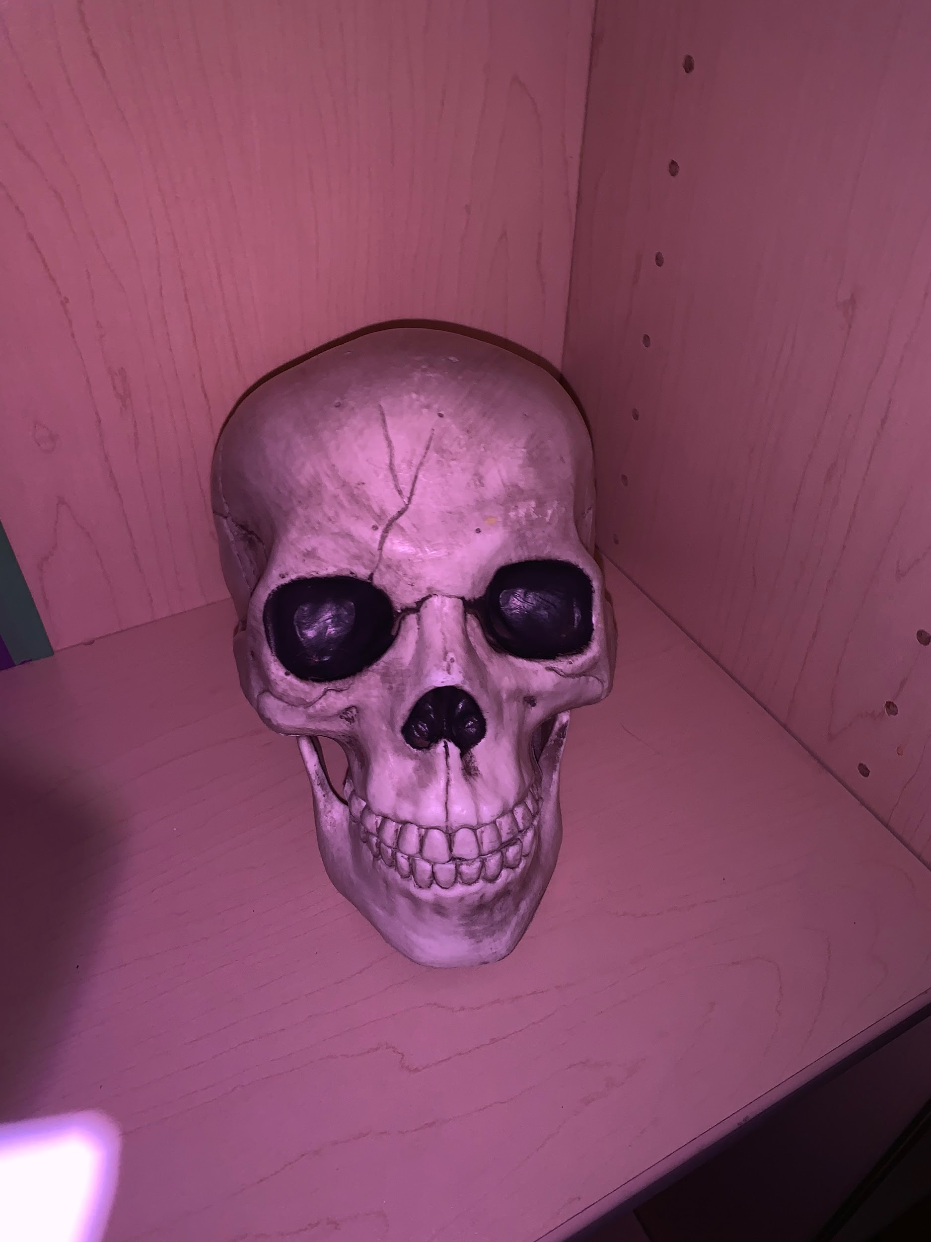
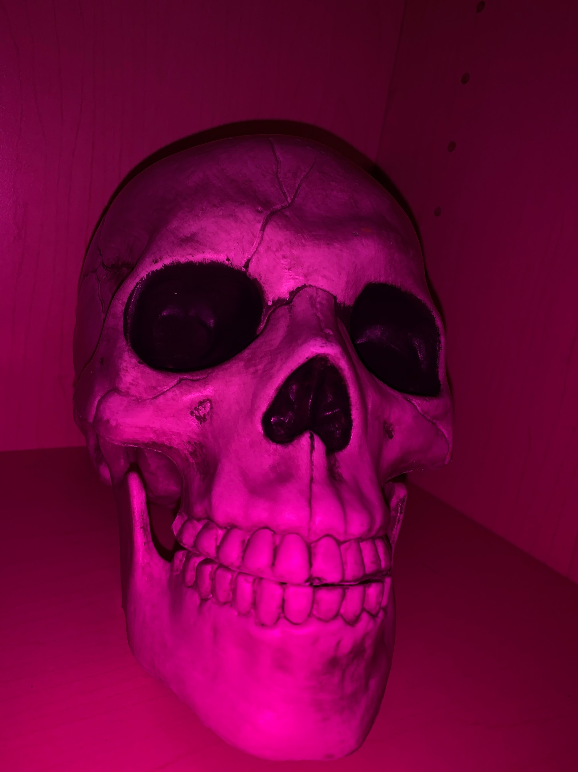
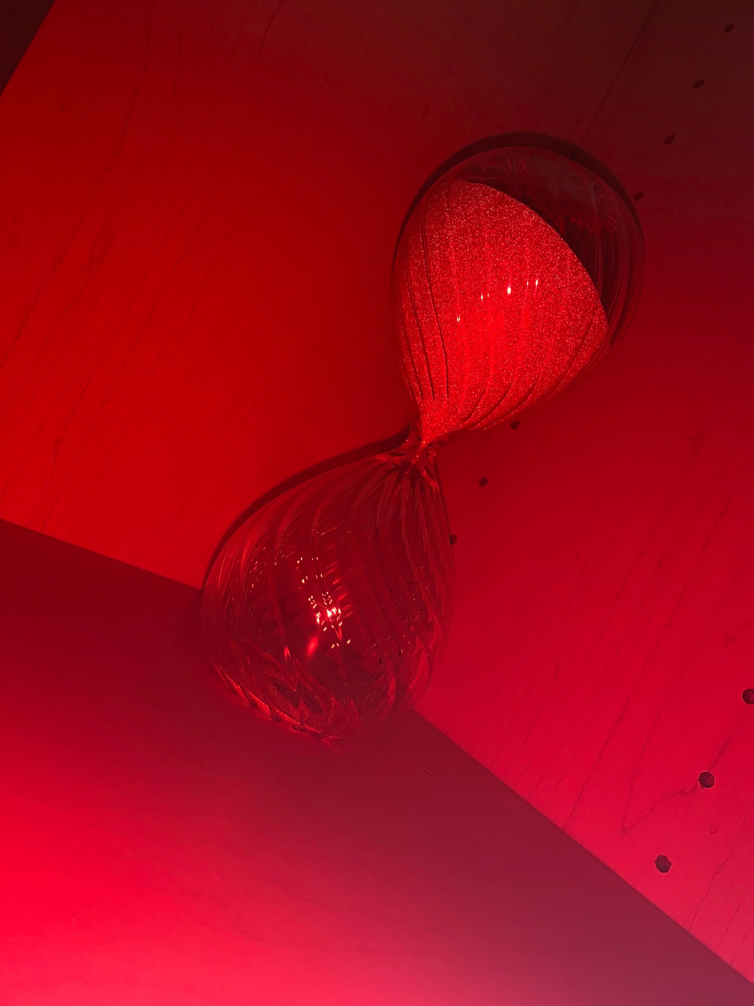
Here Are Some Examples of Different Filters

Slide 11
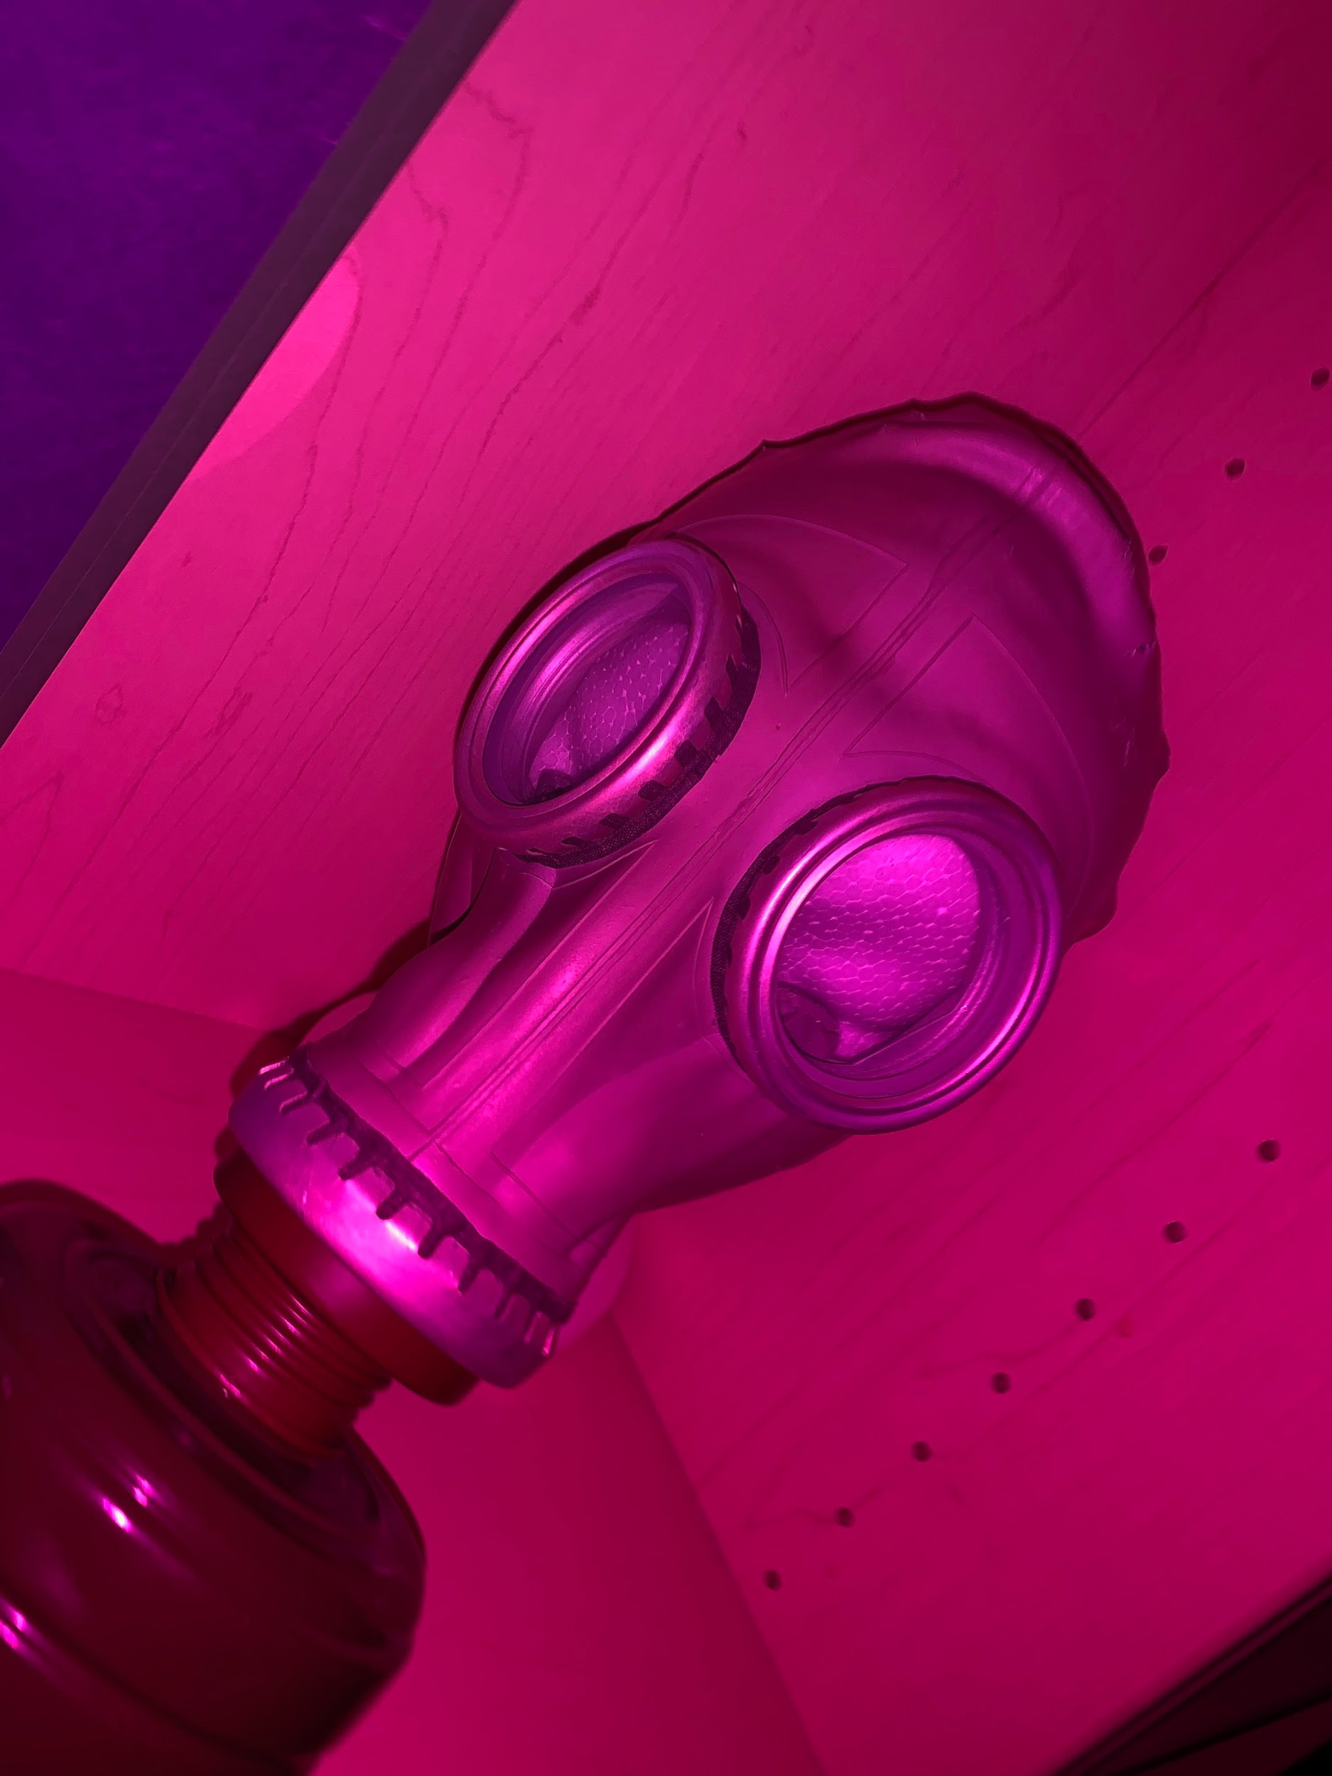
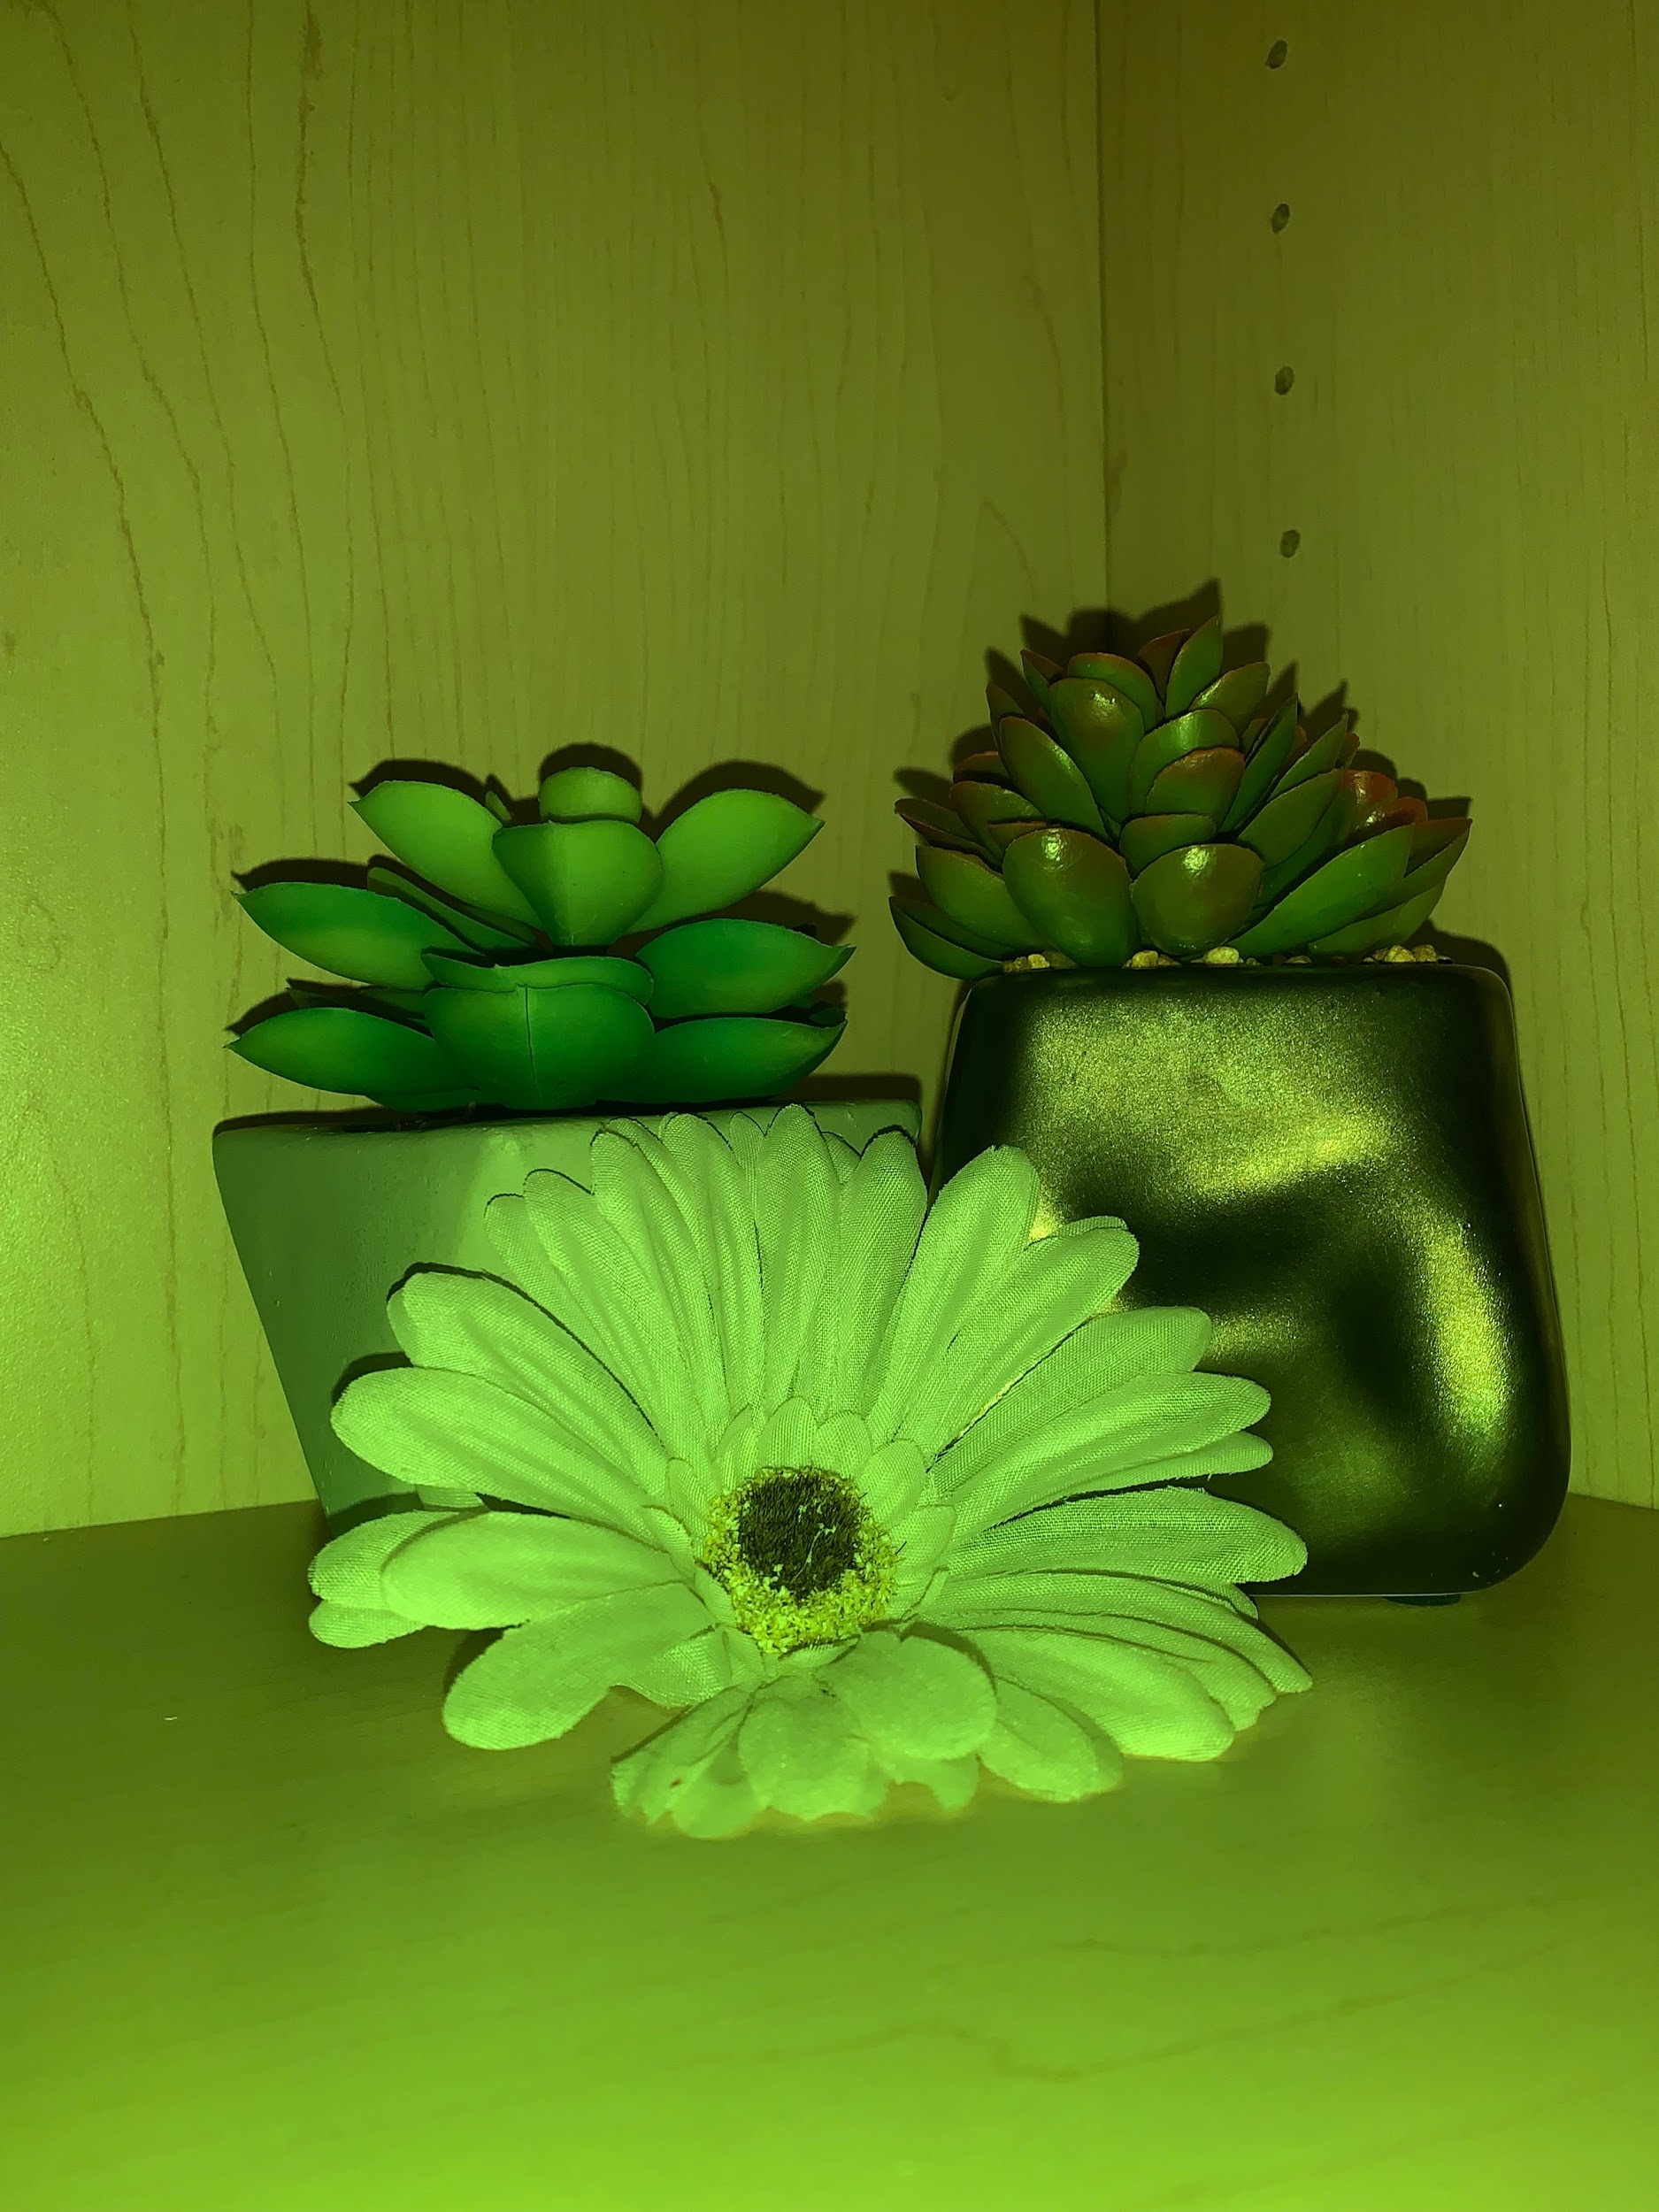
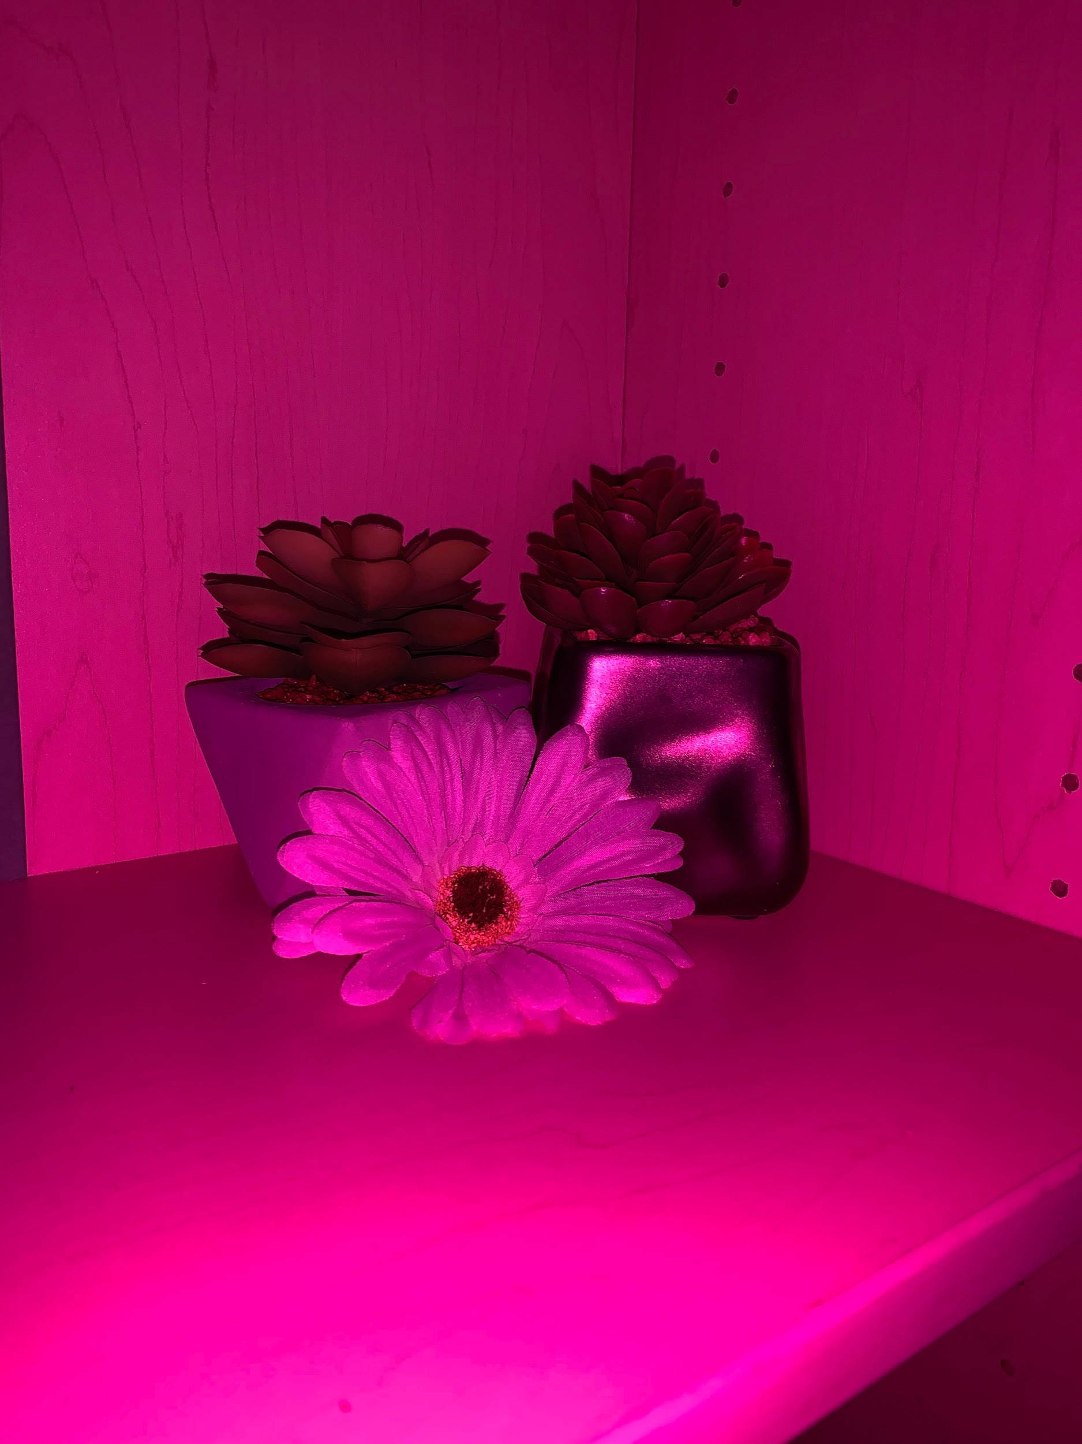
Here Are Some More Examples of Different Filters

