Slide 1
How to do oil abstract photography

Slide 2
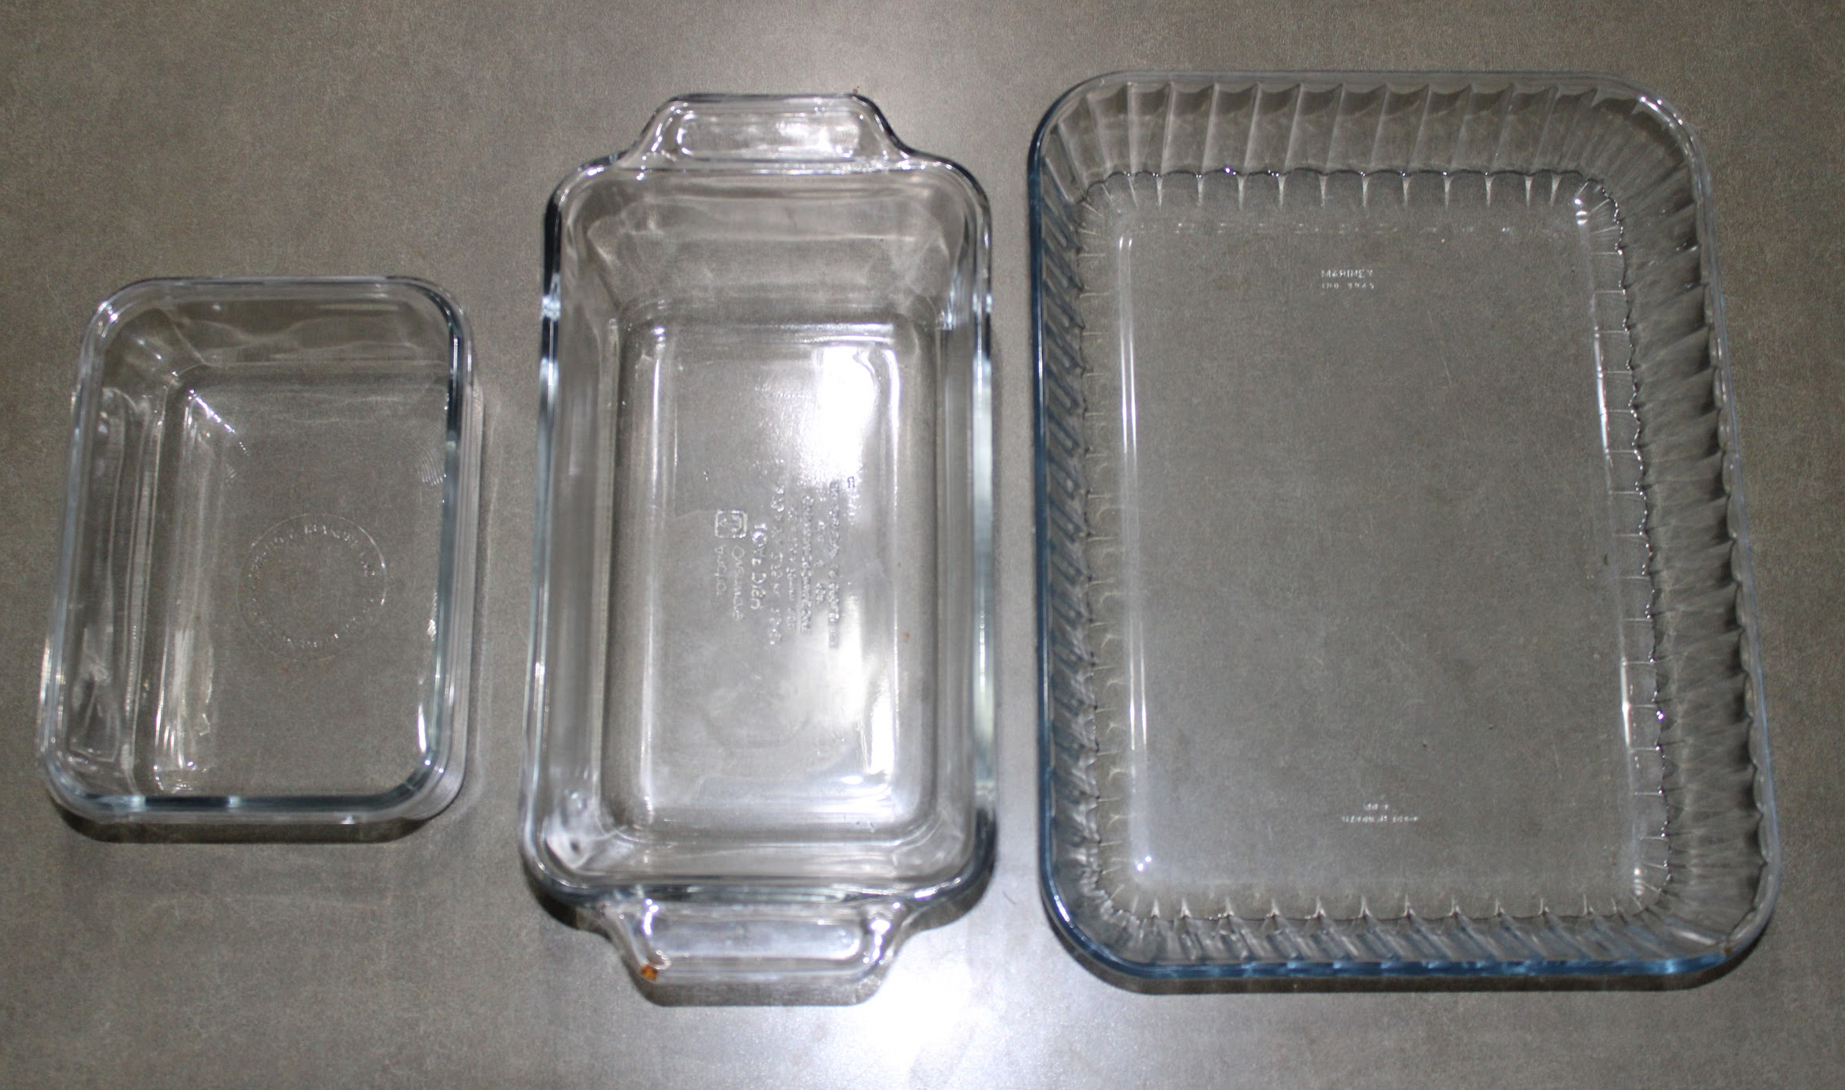
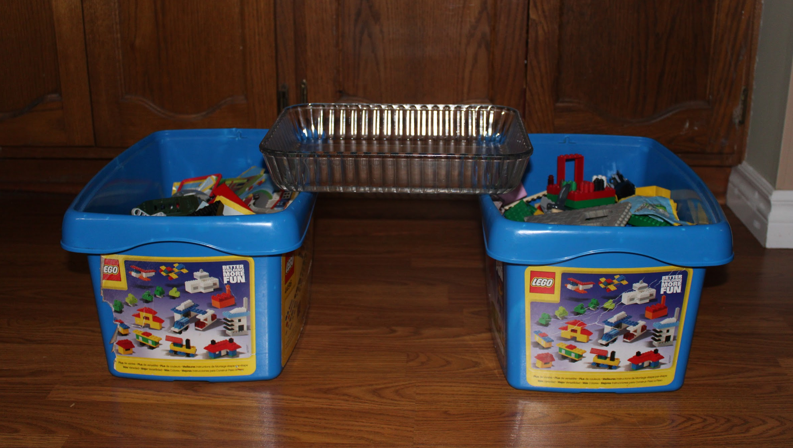
Step one
You will need a clear container that can put the ingredients in (It can be any size).
Then prop it on top of tow towers of some sort. You can use a pile of books or boxes, just make sure it’s the same height on each side.

Slide 3
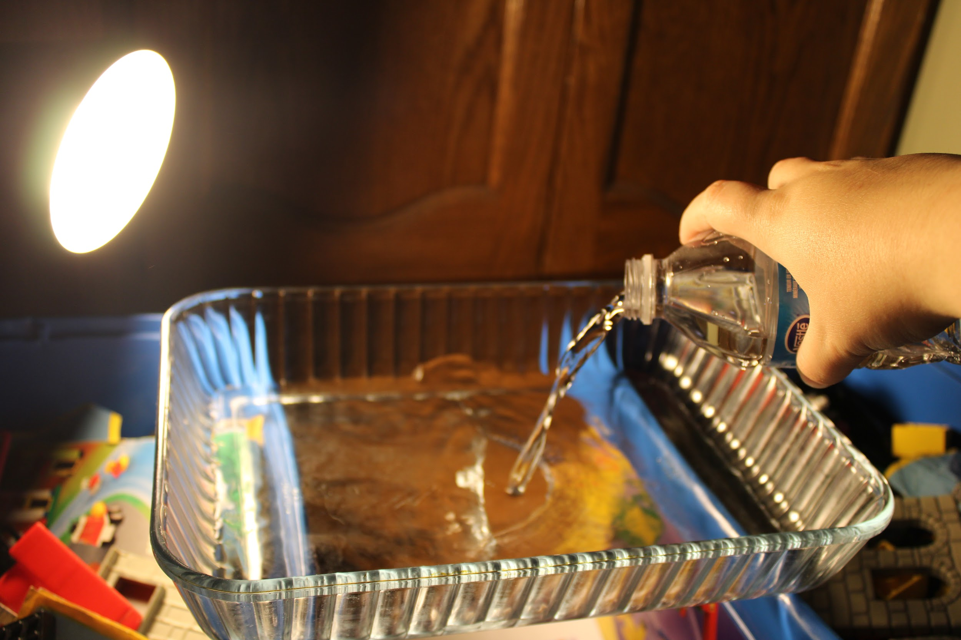
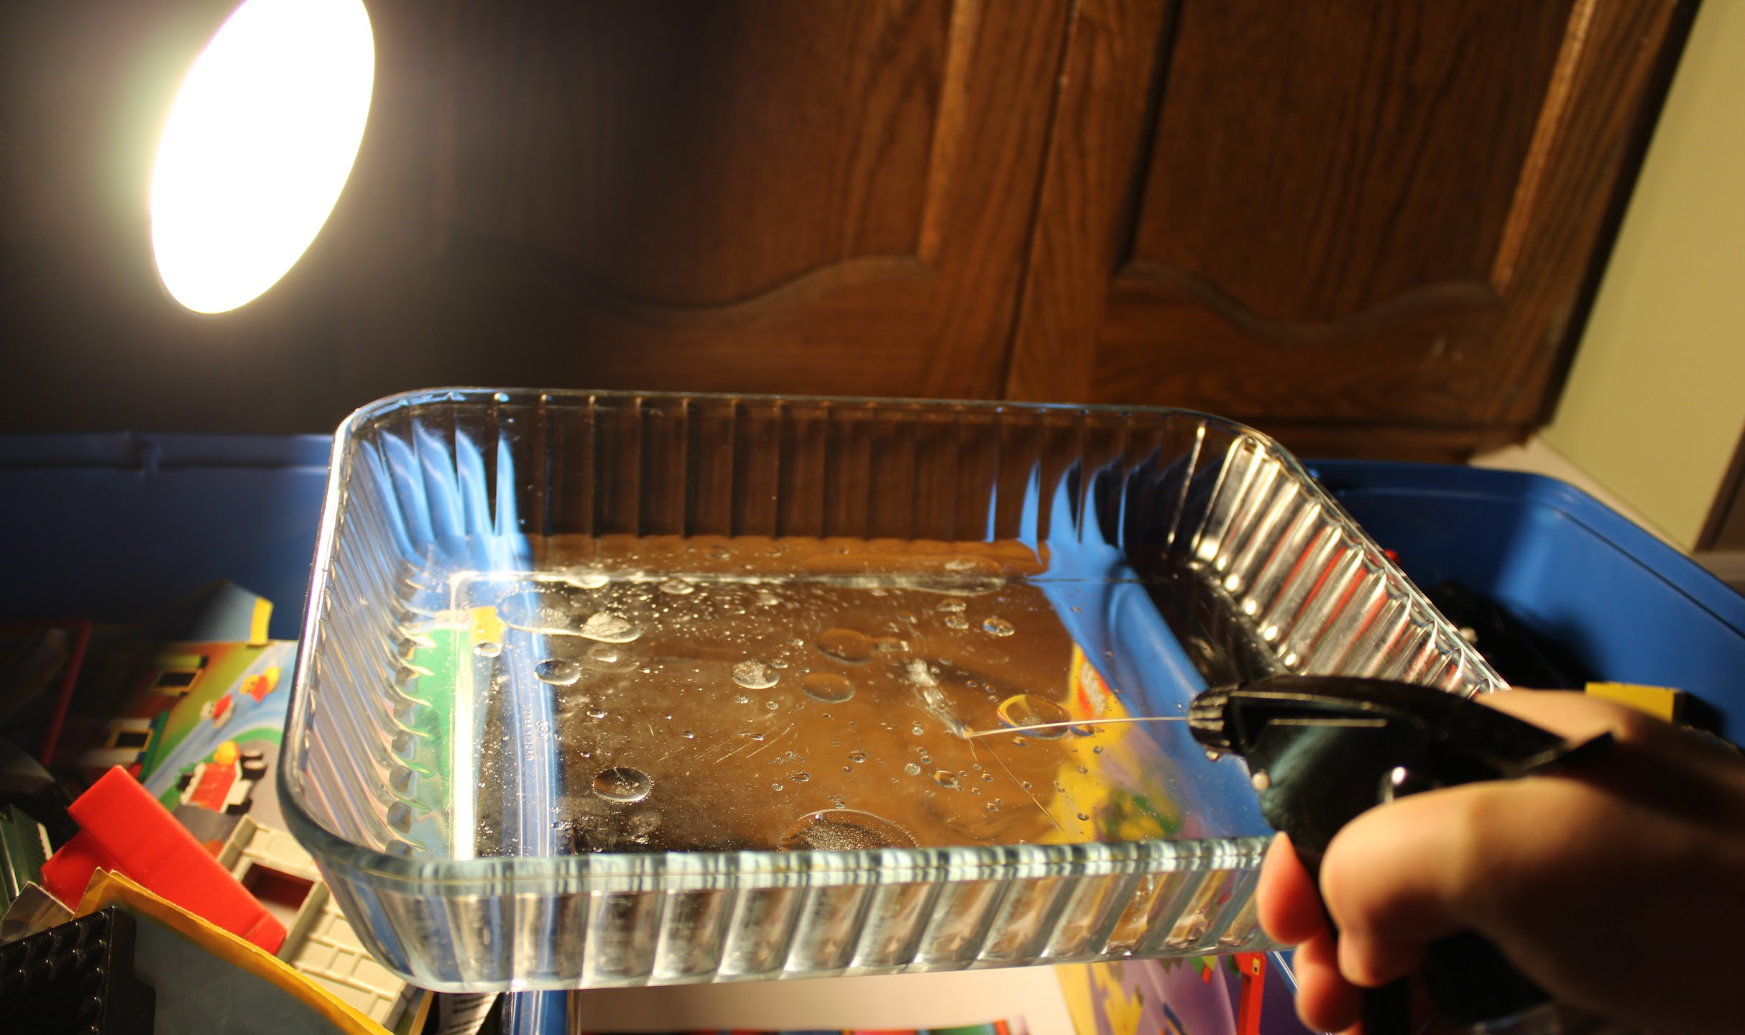
Step two
Pour some water in the clear container. Put about 1 cm or more.
After that you need to add some oil. It’s better to have it in a squirt bottle because then you can get smaller and more bubbles.

Slide 4
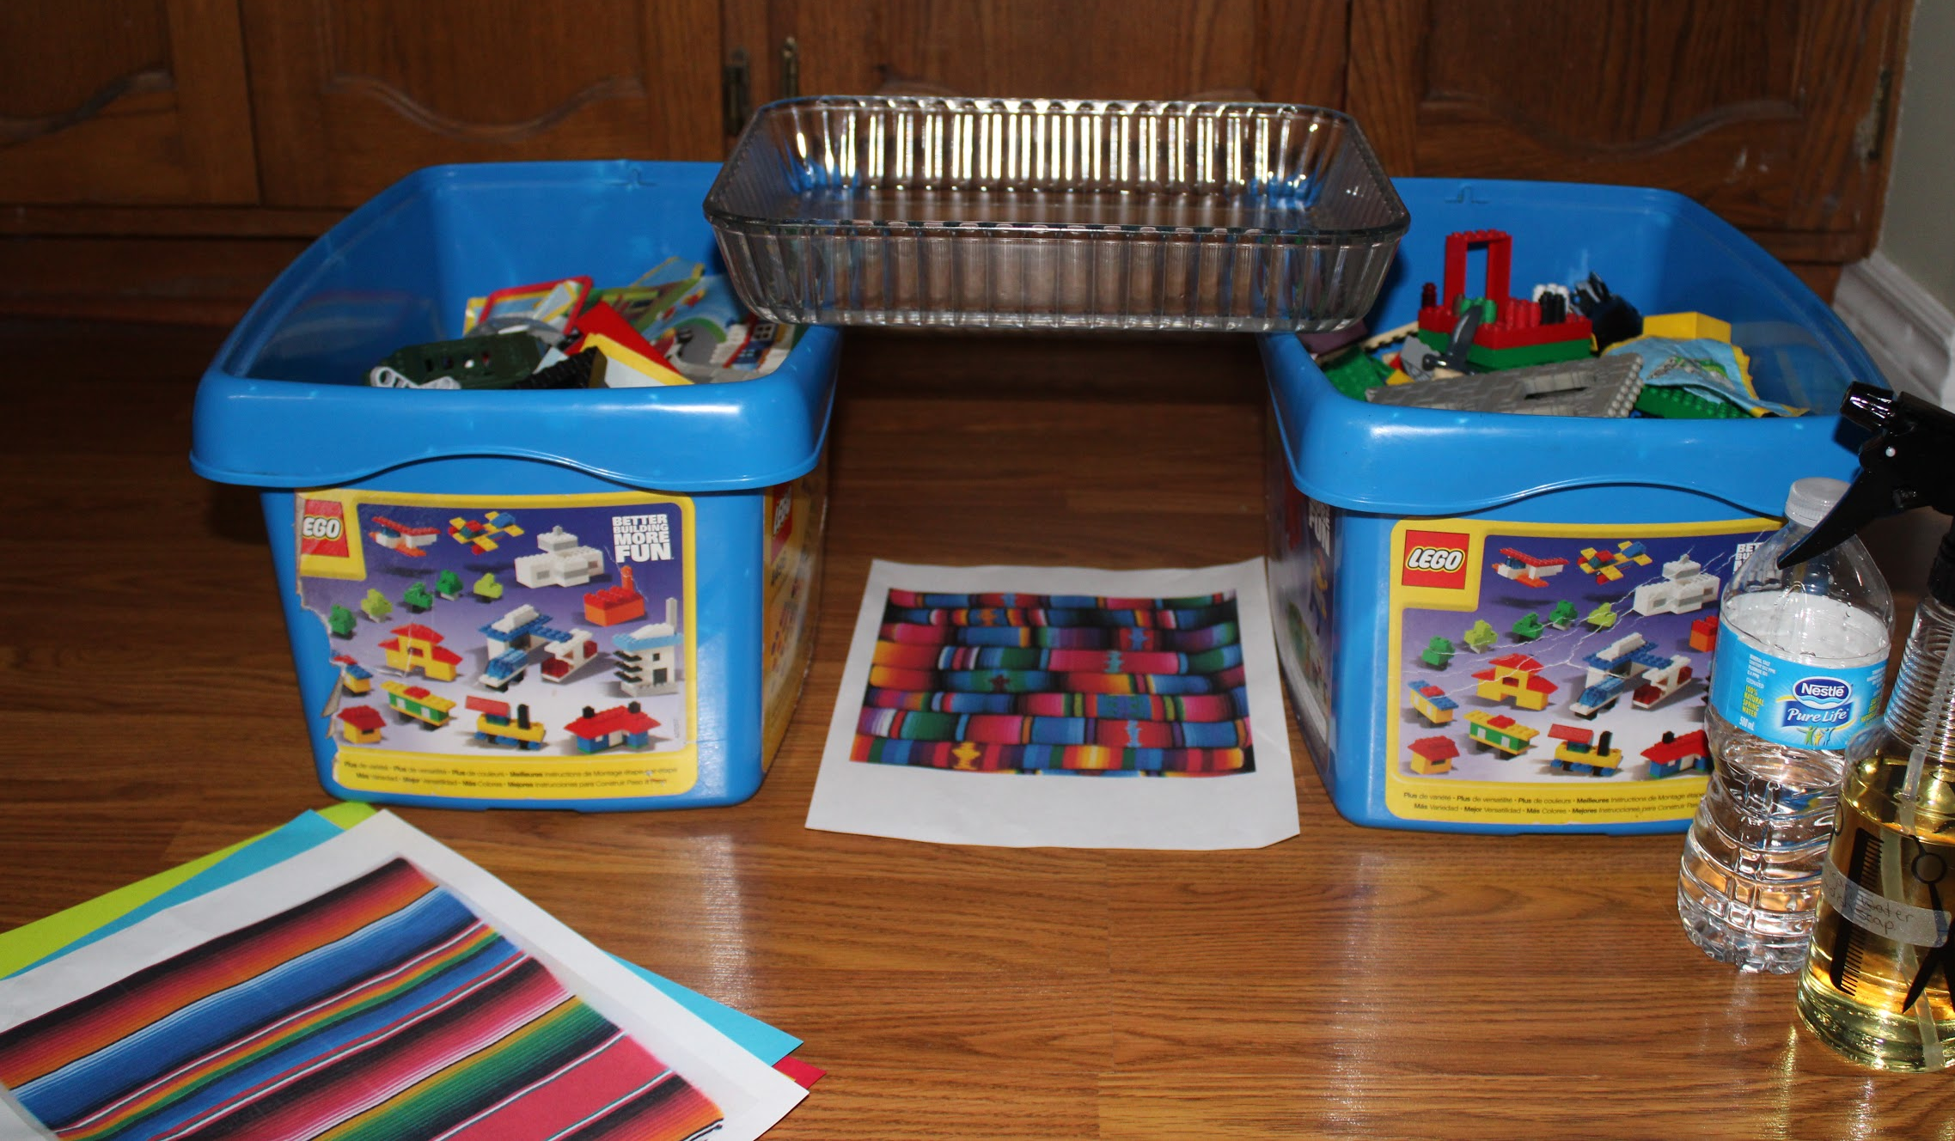
Step three
Then you can put colored idiom or papers under the container to add a little bit of color to the bubbles.
It also helps to turn of all the lits and just have one lite focus on it.

Slide 5
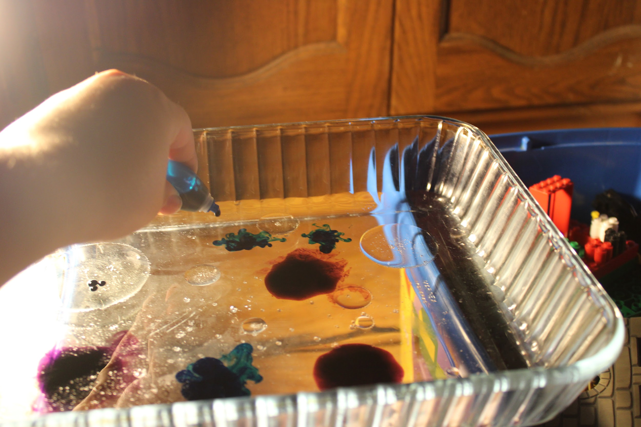
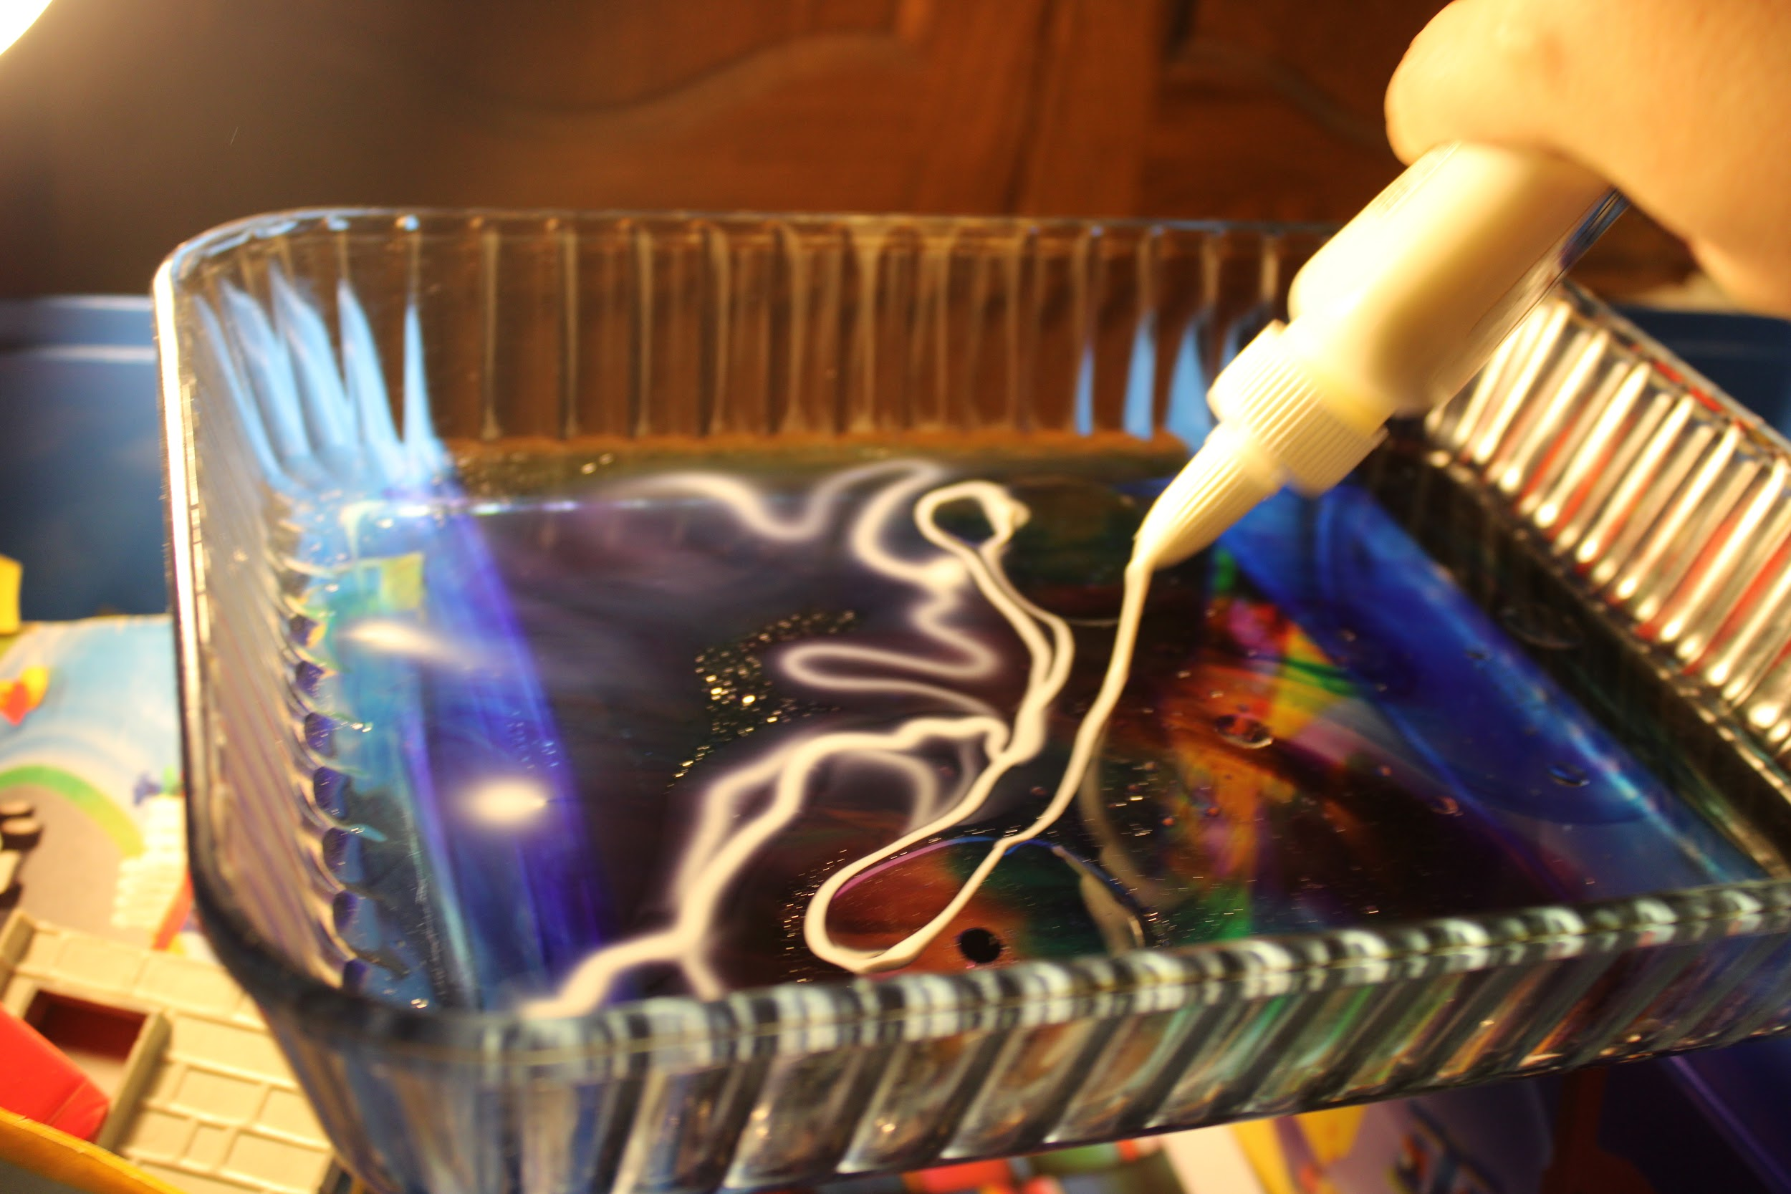
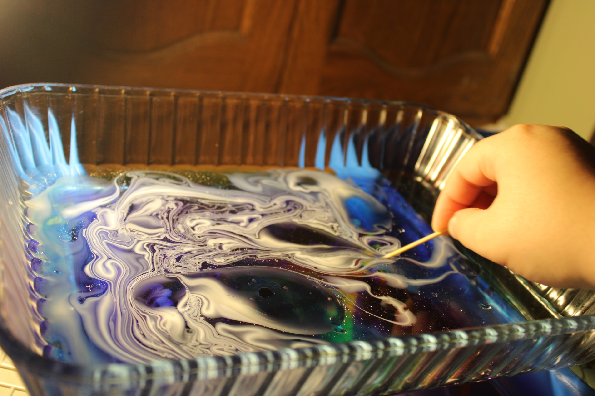
Step four
You can also add food coloring and white glue to make it look cool and more interesting.
Just keep adding things and maybe even mixing until you get what you want.

Slide 6
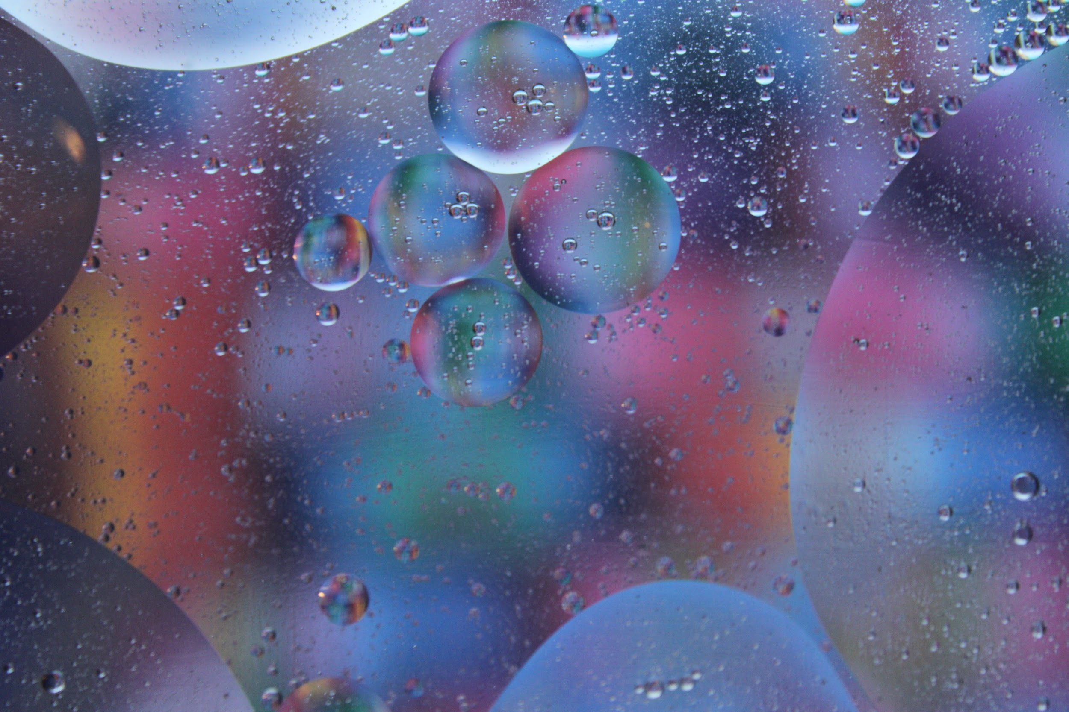
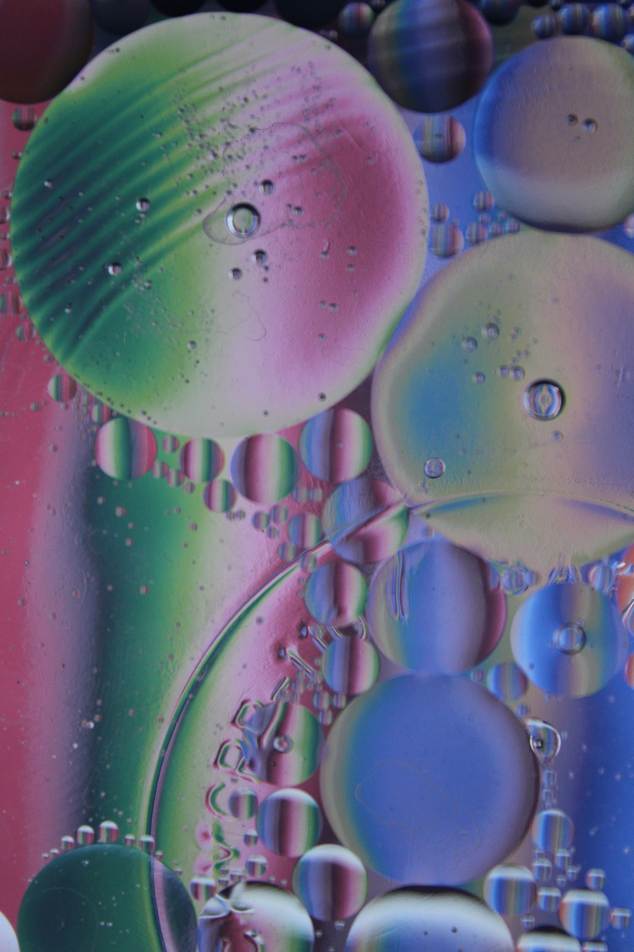
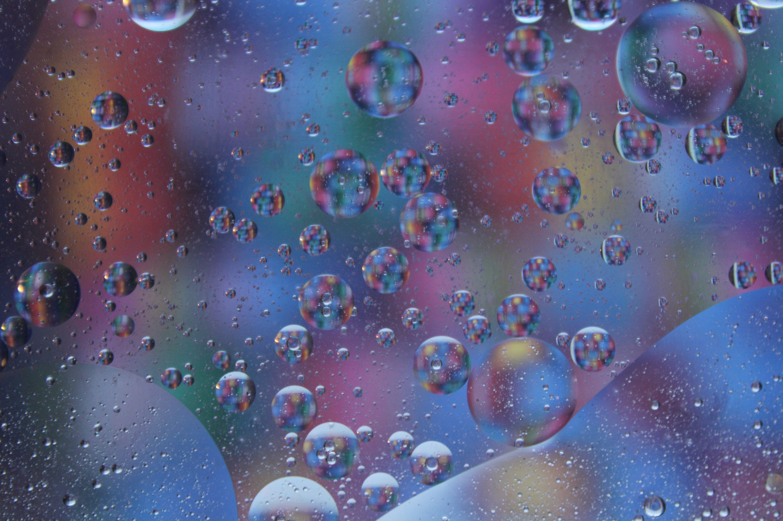
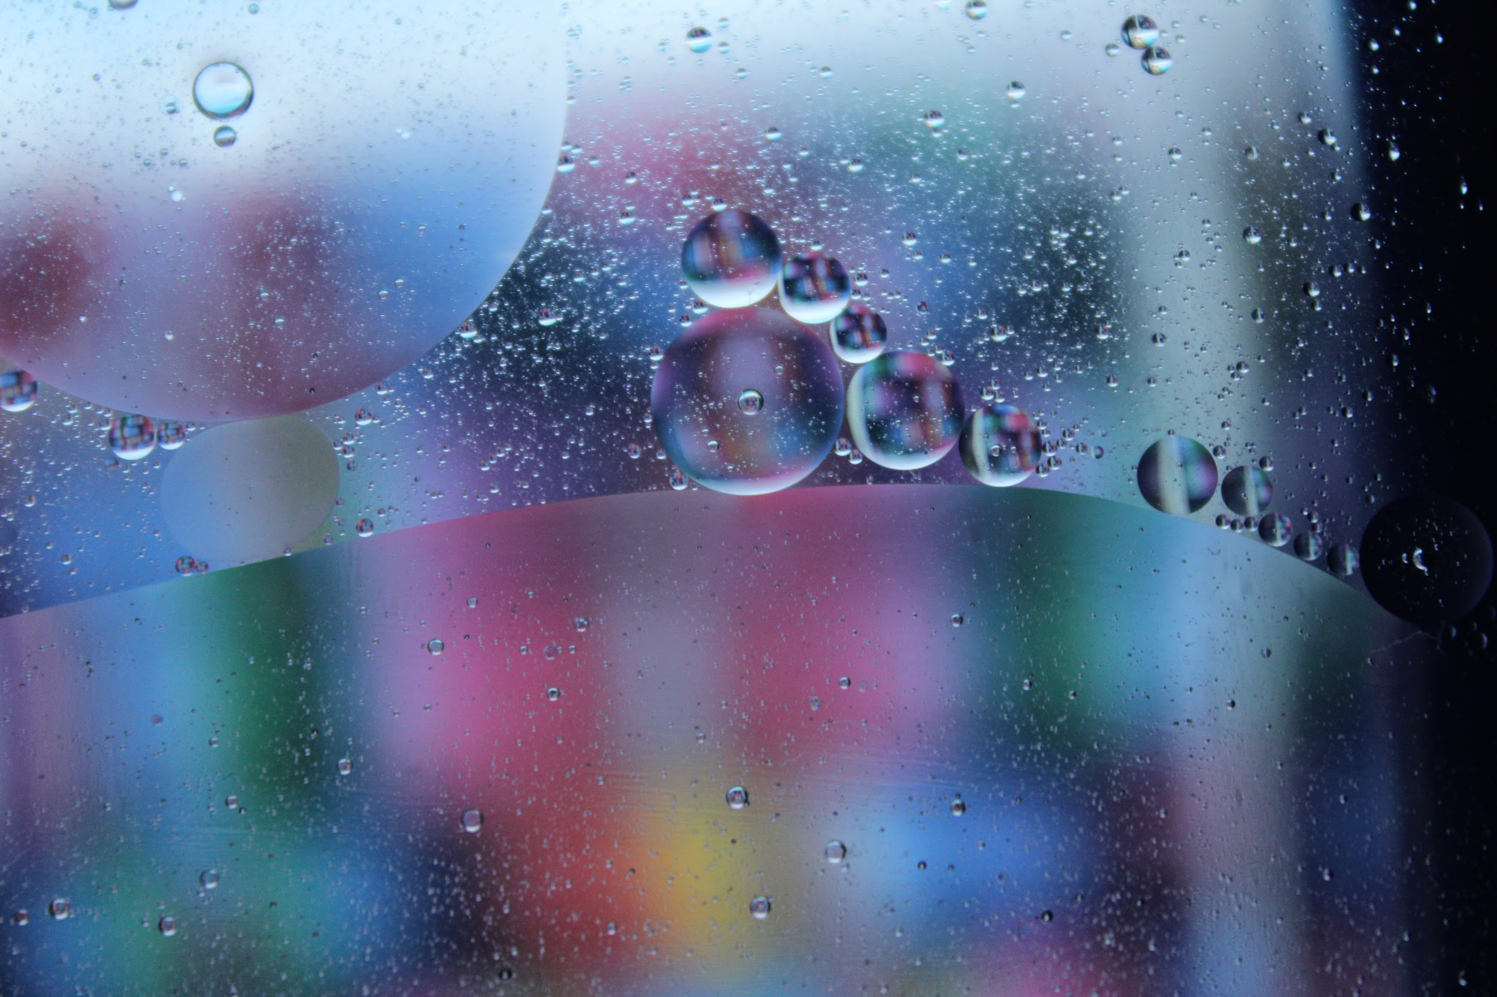
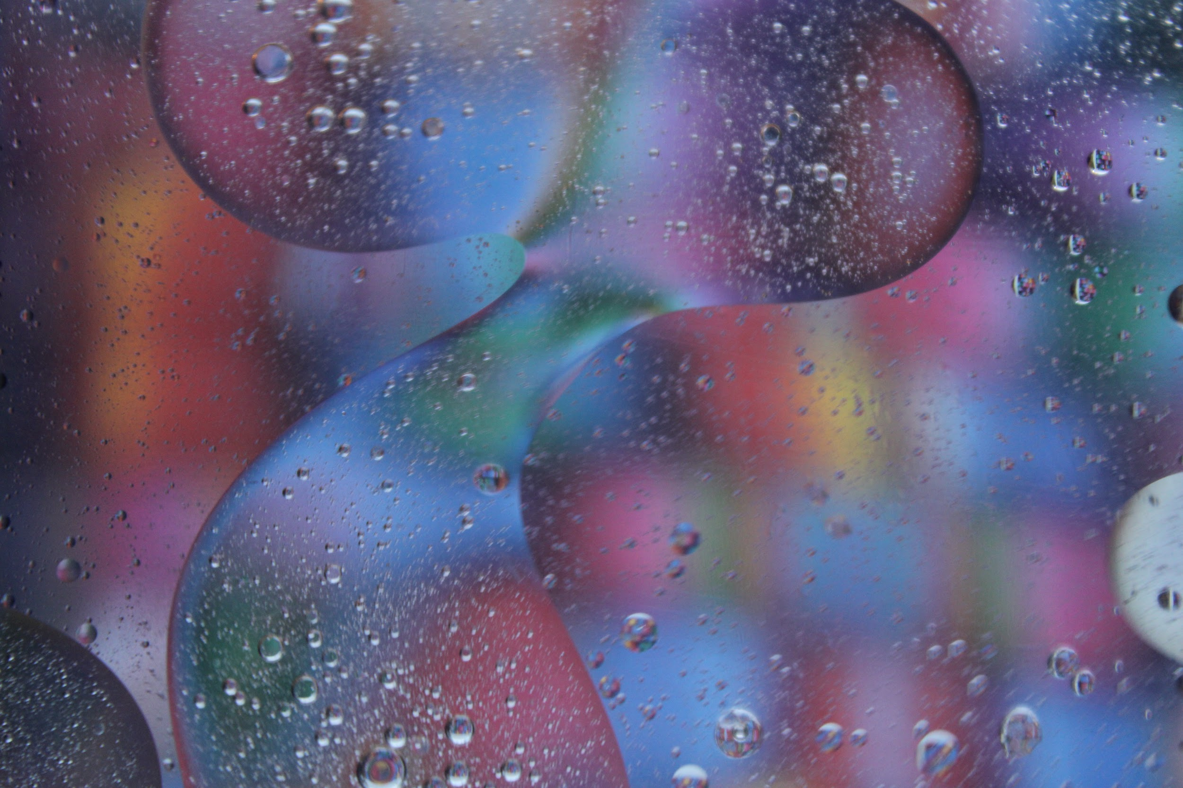
Some results for the Bubble Photography without The glue or food coloring.

Slide 7
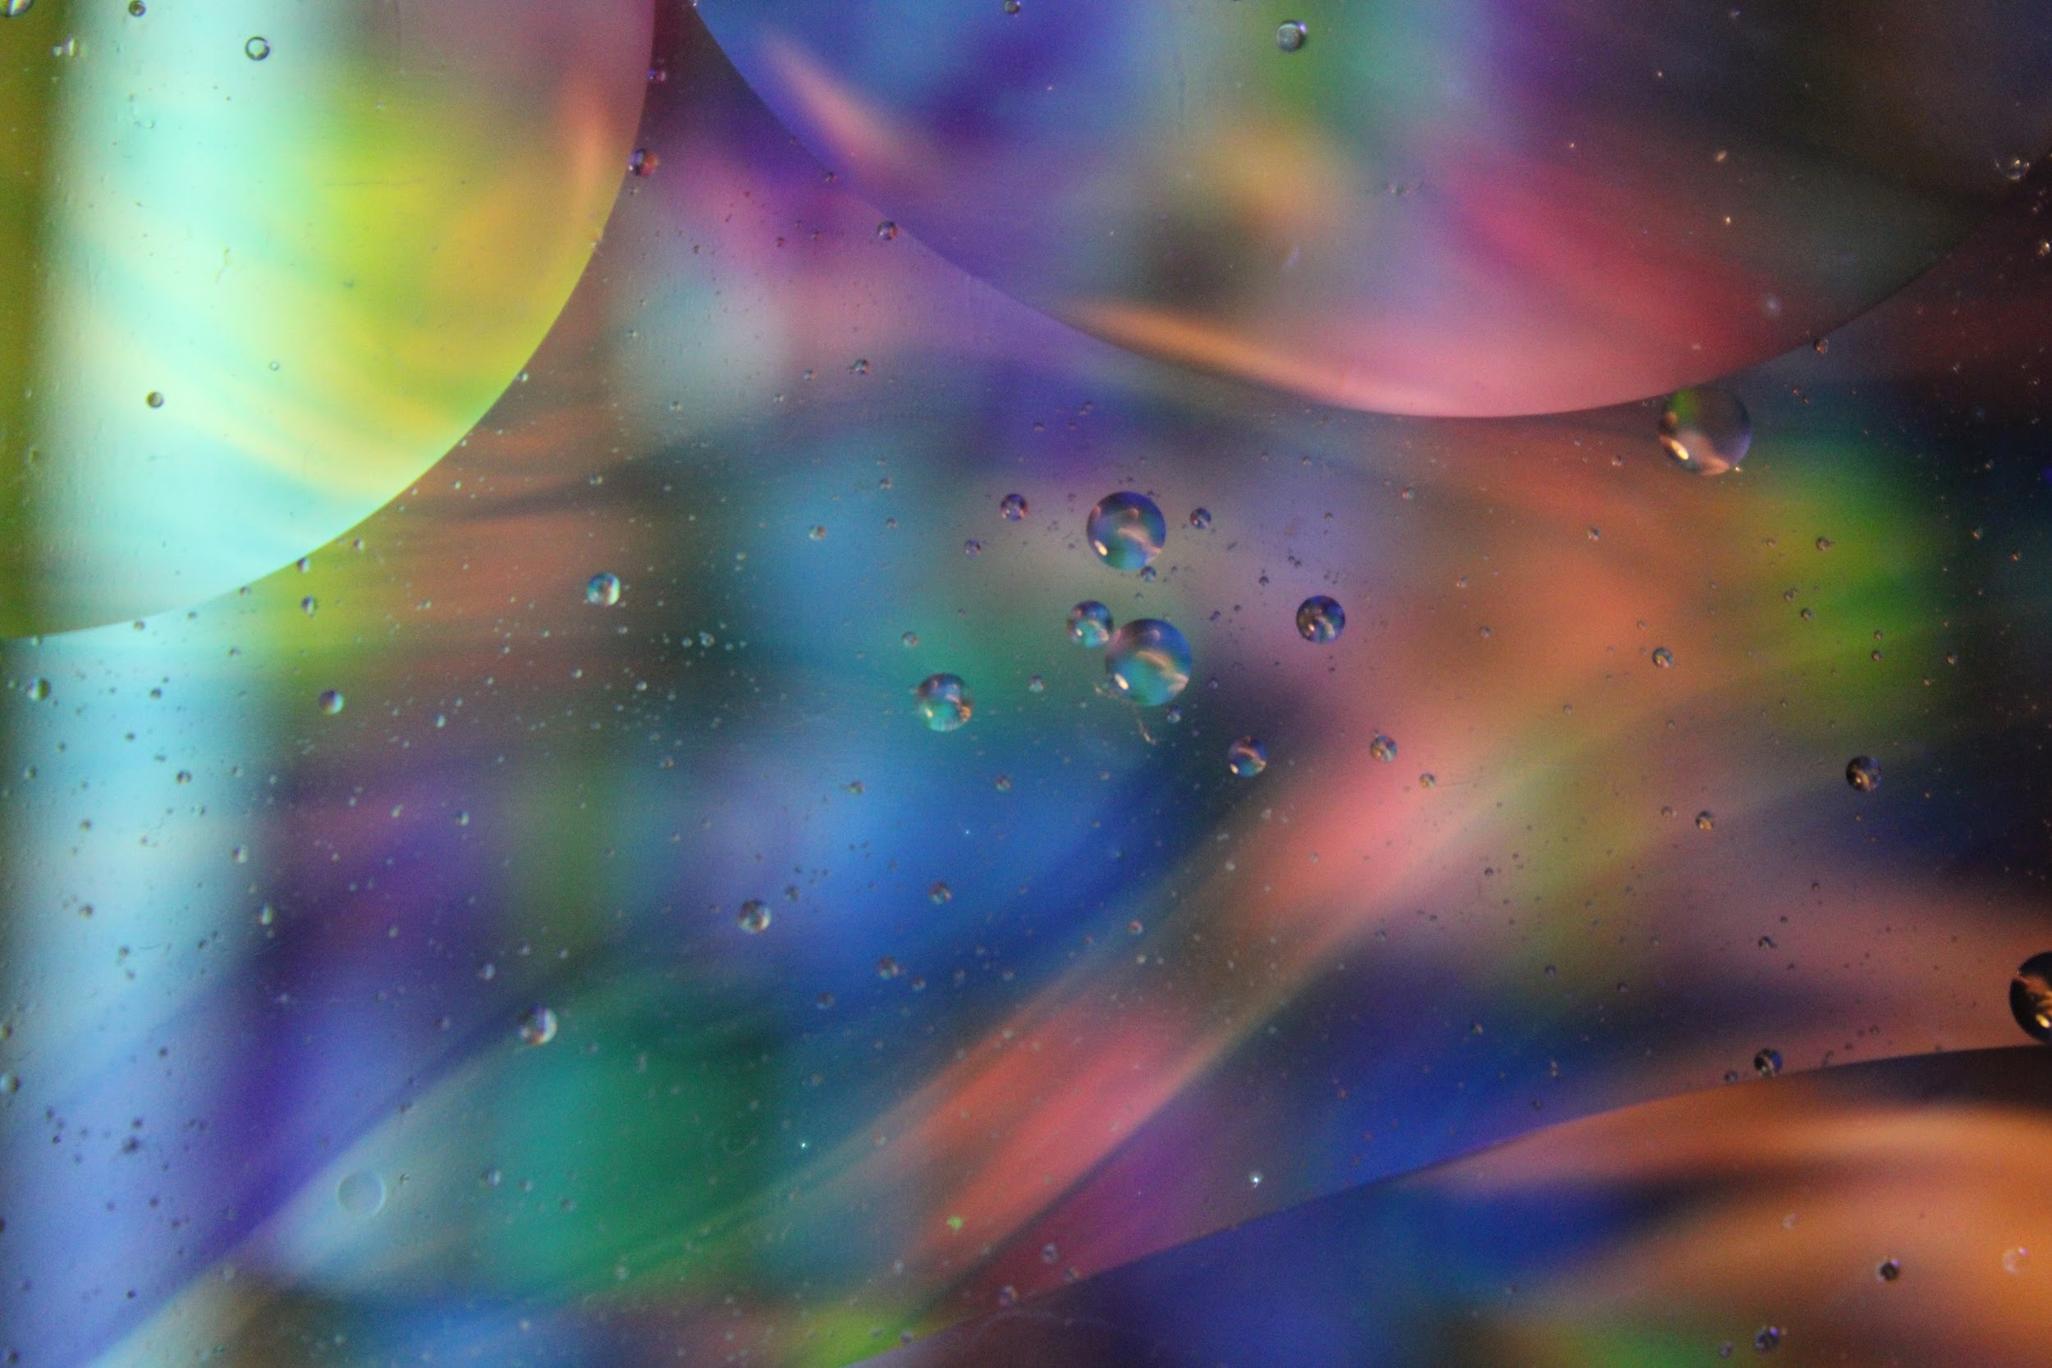
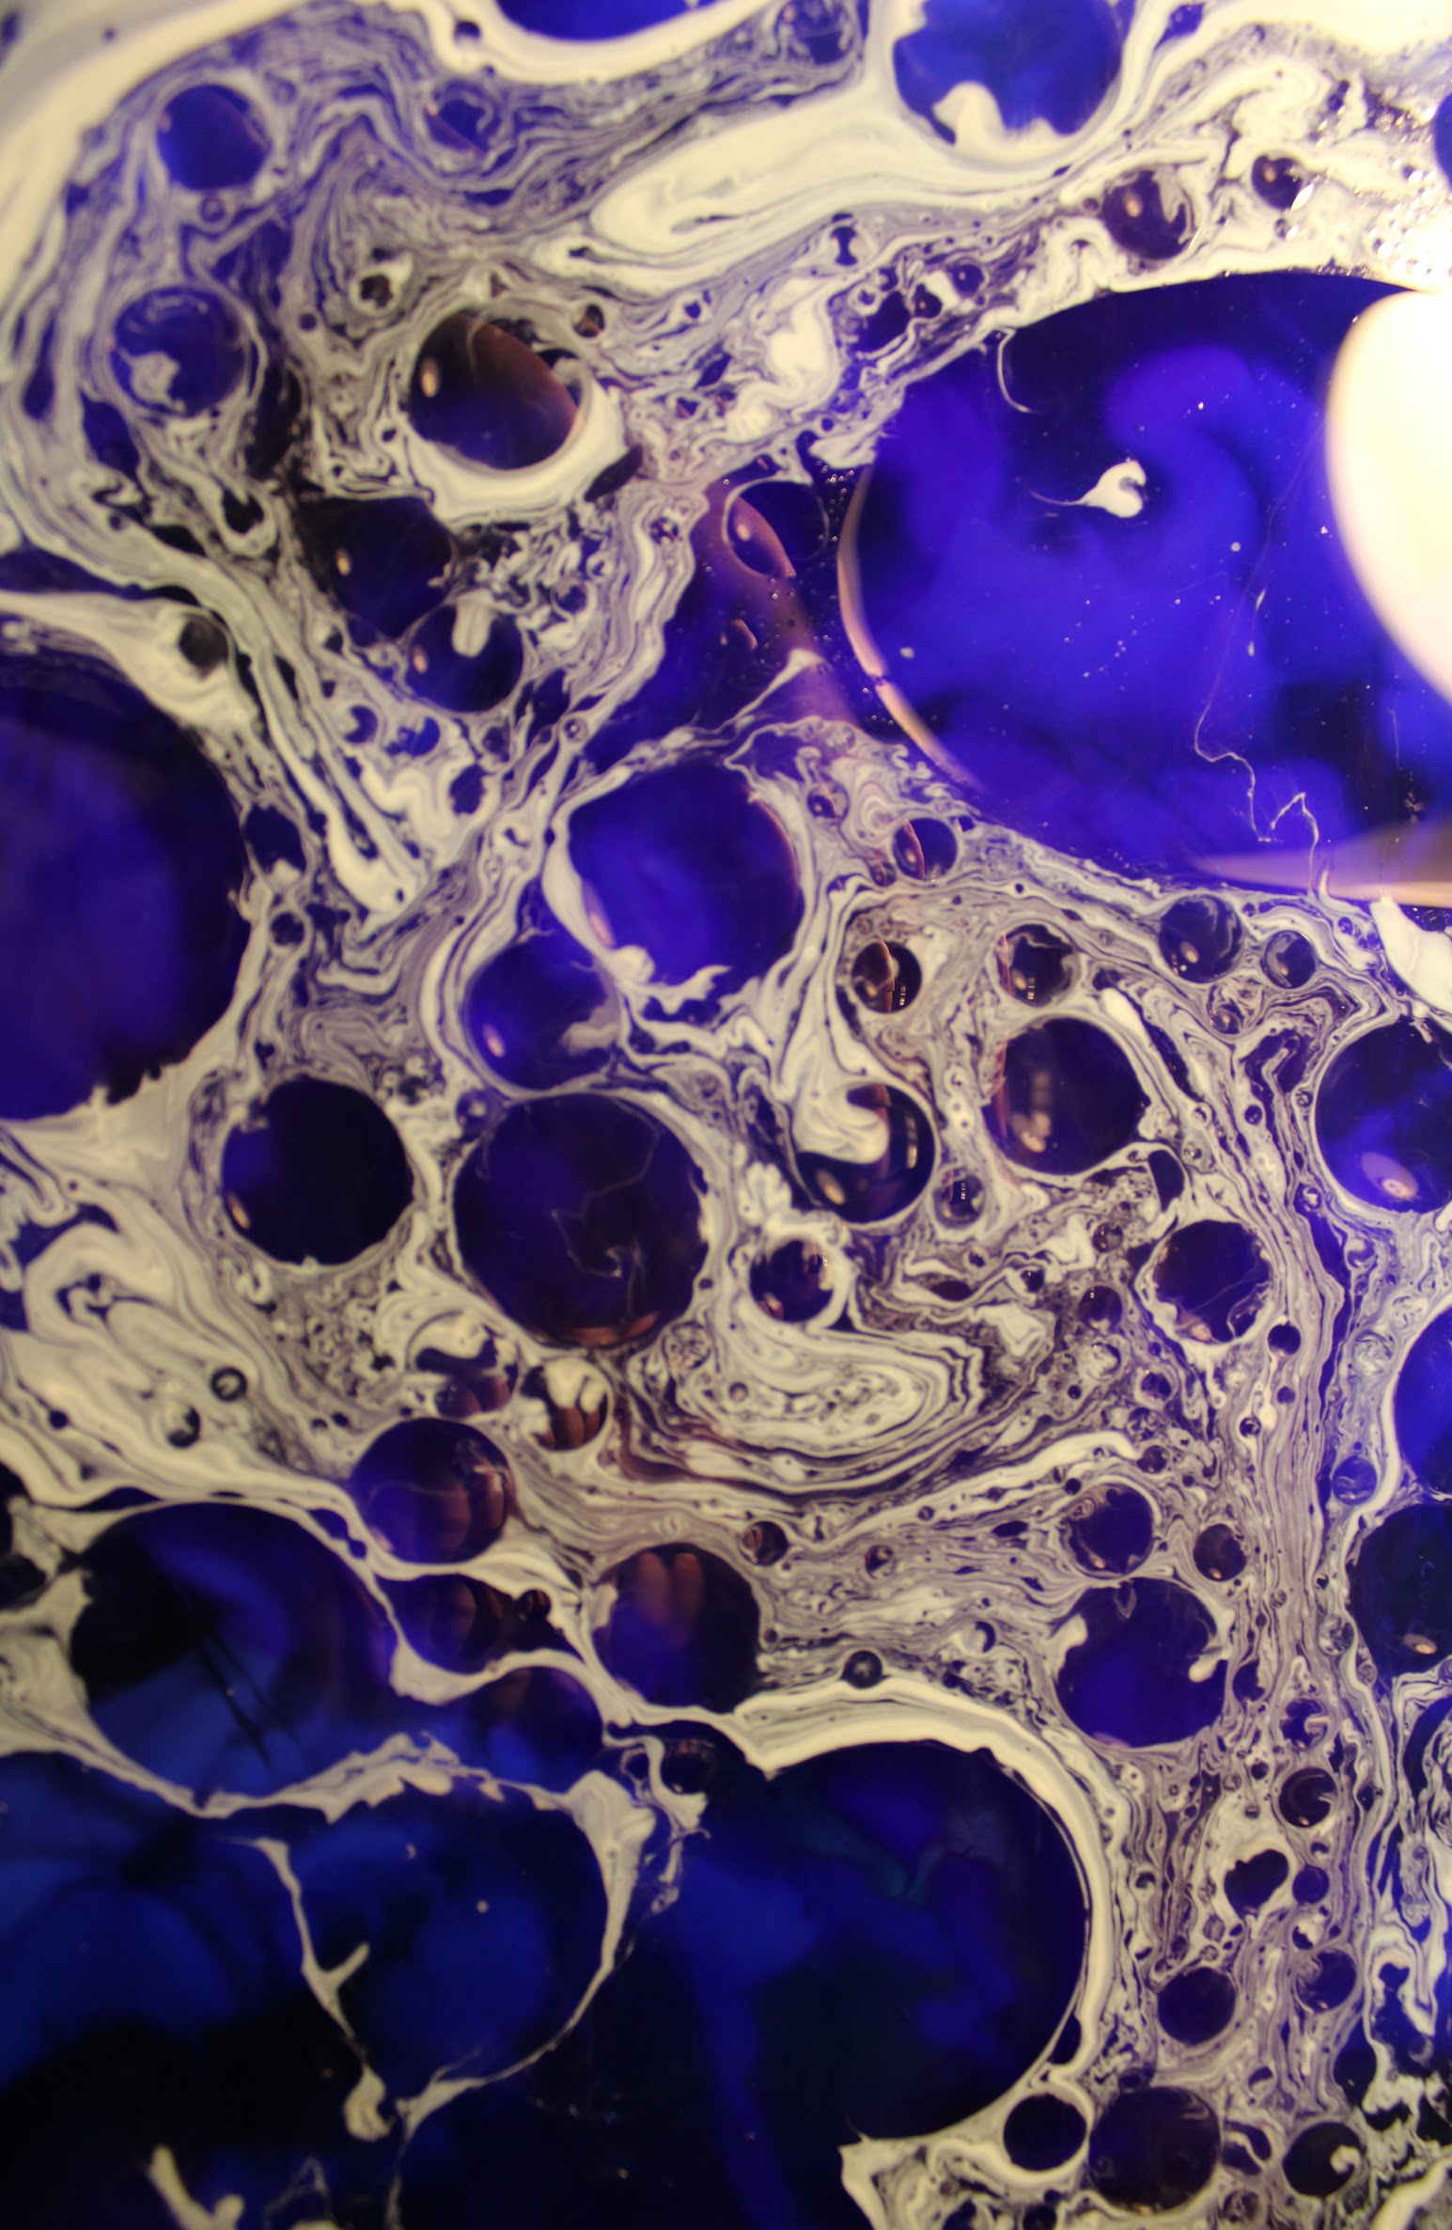
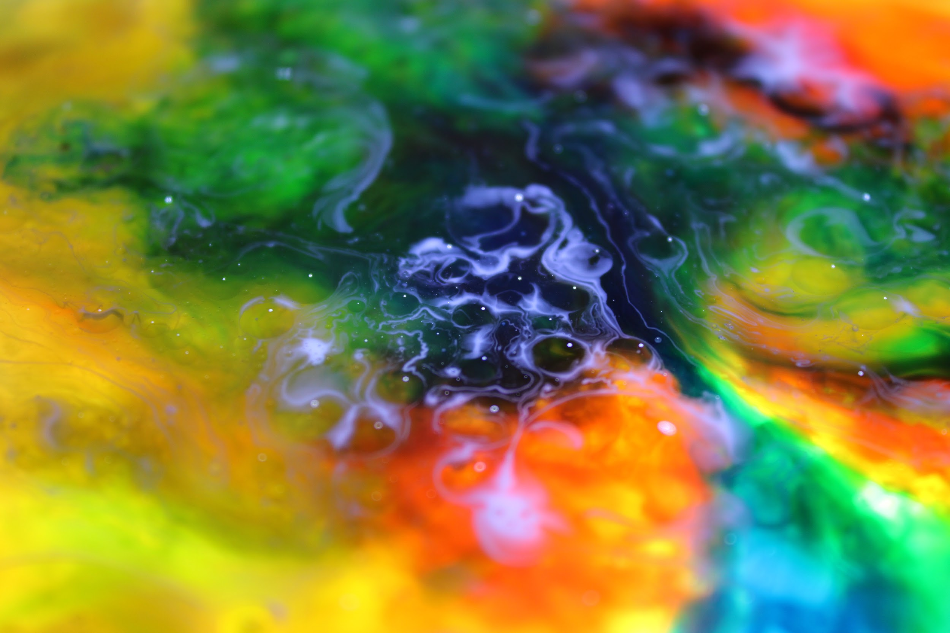
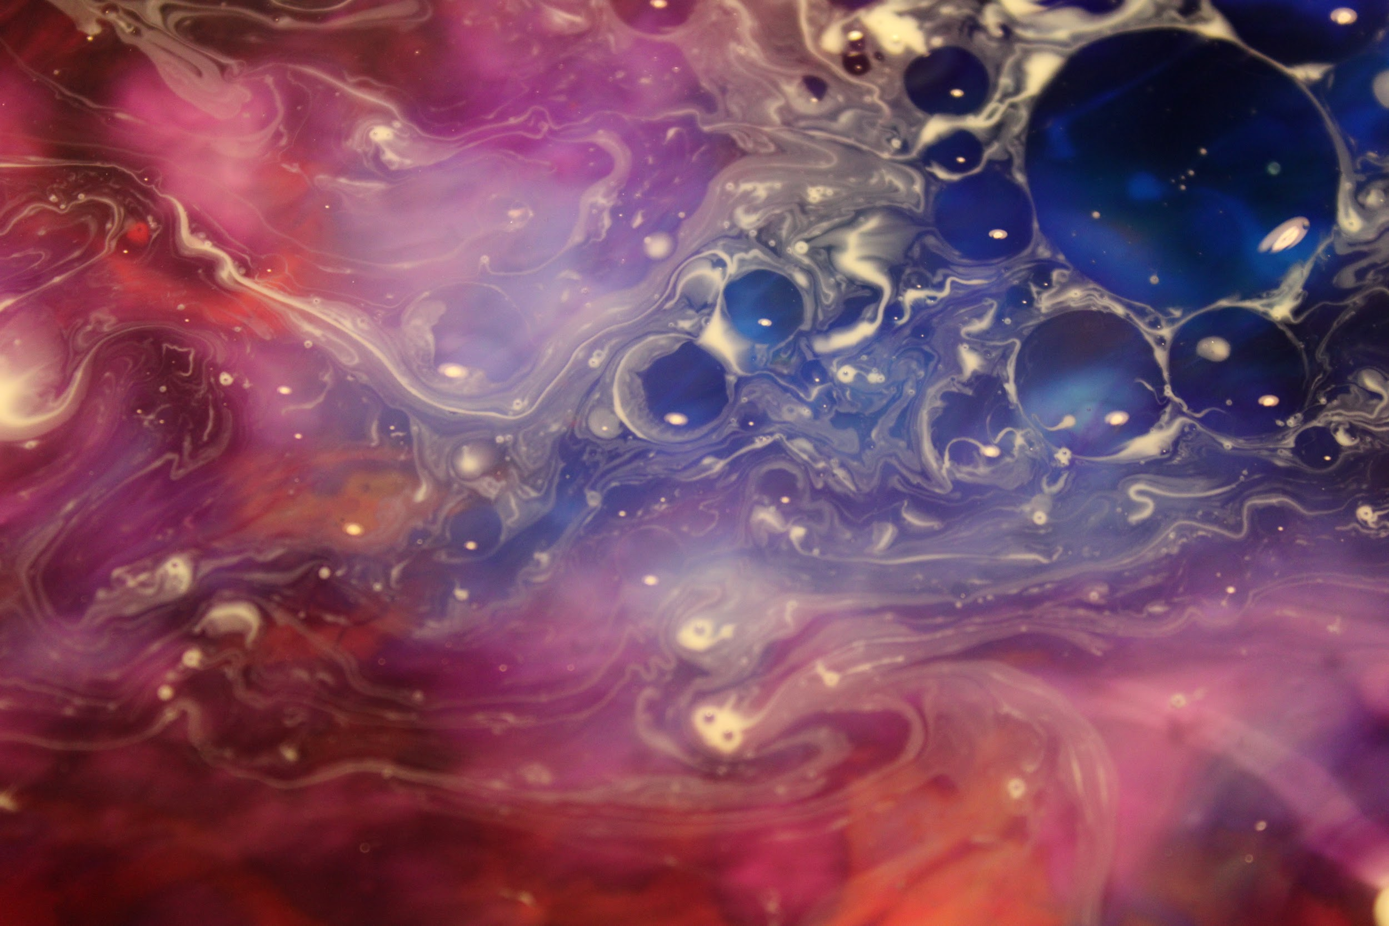
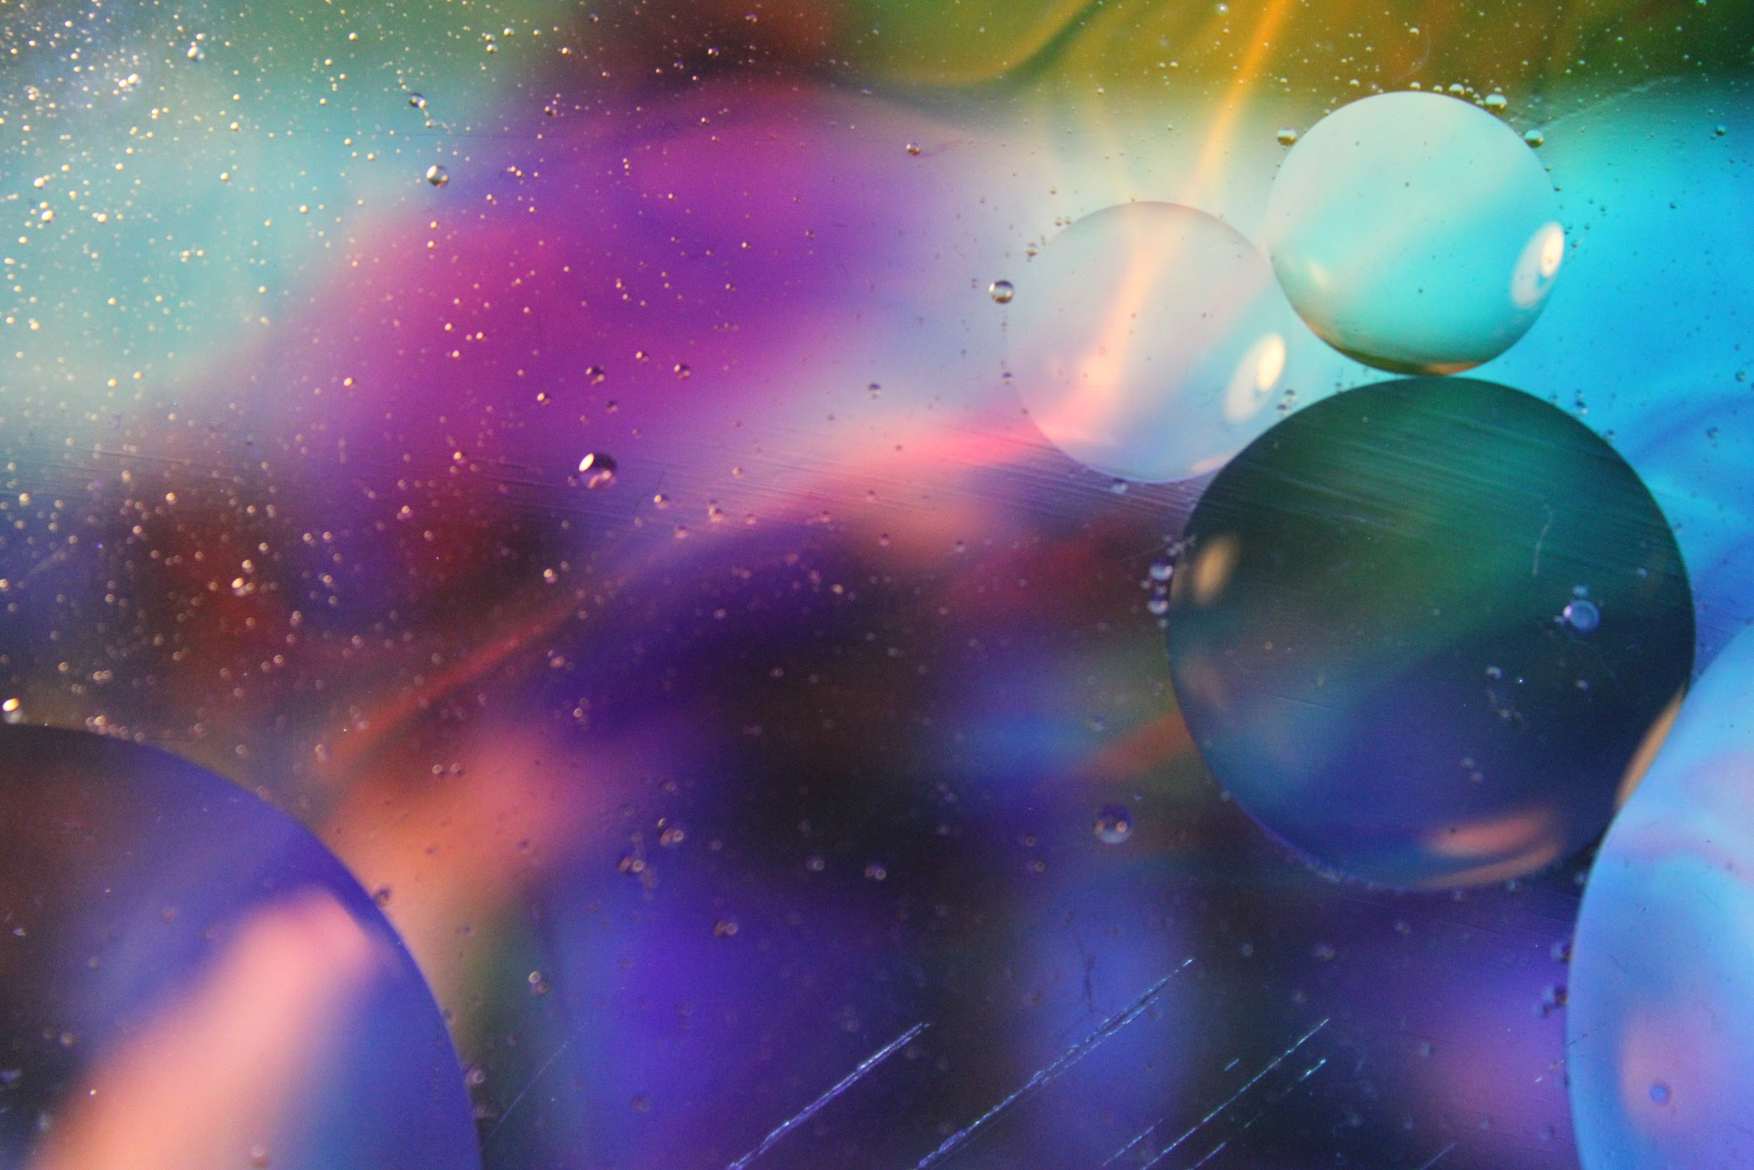
Some results for the Bubble Photography with The glue or food coloring.

